Slide 1
Accreditation Workshop for Faculty and Program Administrators
3 March 2015
Islamabad
Er. Professor Dr. Kai Sang LOCK
Washington Accord Mentor to PEC
Past Chairman, Engineering Accreditation Board, IES
Adjunct Professor, Singapore University of Technology and Design
Organized by
Pakistan Engineering Council

Slide 2
Agenda
6-part presentation
Overview of OBE
Overview of outcome-based accreditation system
Accreditation criteria
Preparing new program for accreditation
Sharing of some common shortcomings
Discussion on outcomes assessment
General discussion

Slide 3
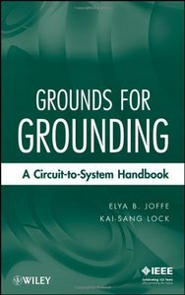
Grounds for Grounding –
A Circuit to System Handbook
Co-author of book

Slide 4
Part 1:
Overview of
Engineering Education Development & Outcome-Based Education

Slide 5


Application of Engineering Principles
The Pyramids
The Great Wall of China

Slide 6
Development of Engineering Education
Engineering and skills found in military – civil & mechanical
Industrial revolution in late 1700s – steam engines and machine tools
Engineering manpower produced through a system of skills-based apprenticeship without much formal classroom training

Slide 7
Development of Engineering Education
1800s – formal engineering education on disciplinary knowledge with grounding in mathematics and sciences
1900s – continued to be practice-oriented, with many experienced engineers engaged in teaching & sharing engineering practice
Since late 1900s – expansion of scientific and engineering knowledge
  Early specialization in narrow disciplines
  Increase in teaching of engineering sciences

Slide 8
Concerns
Faculty became more dominated by researchers who had little real industrial experience.
Curricula were often packed with course modules proposed and taught by professors.
Many of these courses were related to the professors’ own areas of expertise and were offered without a critical evaluation of the requirements of an integrated curriculum.
Graduates from engineering programs were often found lacking in competencies required in real-world engineering employment.

Slide 9
Objectives of Engineering Education
Unending debates among the engineering community regarding the fundamental requirements of engineering education in a typical undergraduate program.
Should be answered by examining the social, economical and technological environment under which the graduates will practise, not just for the present but also for the anticipated future scenario.
Not realistic to have one-size-fit-all approach.
In less developed countries, engineers will continue to engage in solving basic problems such as access to water, electricity and housing.
The traditional practice-oriented and discipline-focused curriculum is still applicable.

Slide 10
“Educating the Engineer of 2020” - the National Engineering Academy (NEA), USA
The steady integration of technology in our public infrastructures and lives will call for more involvement by engineers in the societal context, and demanding attributes in communication and people skills necessary for effective interaction with technical and public audiences
A growing need for interdisciplinary and system-based approaches
Producing engineers with core knowledge, capable of defining and solving complex problems, and are lifelong learners
Attention to ethical issues in engineering
Reinventing engineering education requires the interaction of engineers in industry and academe

Slide 11
Purpose of an Education Program
The purpose of an education program is broadly articulated in the accreditation jargon as Program Educational Objectives (PEOs).
PEOs are broad statements that describe the career and professional accomplishments that the program is preparing graduates to achieve.
These objectives are periodically reviewed based on feedback of the program’s various constituencies.
For this purpose, there should be in place a process to identify and document relationships with constituencies (who are expected to include students) and their needs which have to be adequately addressed when reviewing the curriculum and processes.
Published PEOs should be consistent with the mission of the educational institution and the stipulated student learning outcomes and the curriculum and teaching processes that lead to the attainment of these objectives.
The objectives should be assessable and realistic within the context of the committed resources.

Slide 12
Traditional Education System

Slide 13
Premise of traditional approach
The premise that good raw materials (the students) plus good production system (institution resources) will automatically produce good products (the graduates).
Evaluation of the quality of the graduates is based on comparative student grades and rankings.
The curriculum is structured mainly based on the available expertise and preferences of the faculty. The system is content-based and teaching-centric.
The emphasis is on the input and output of the education system. The important input parameters are the available resources, the number of qualified teachers and the student intake quality.
The output quality is based on measuring the student’s mastery of the defined body of disciplinary knowledge and their performance with the defined curriculum.
The mastery is based on content acquisition and retention.

Slide 14
Development of Outcome-based Education
OBE has been implemented since the 1980s with various forms at different levels of the education system, from nursery/primary schools to postgraduate schools
Outcome-Based Education is well-defined by Wiiliam Spady [5], often called the father of OBE, as:
  Defining, designing, building, focusing and organizing everything in an education system on the things of lasting significant that we ultimately want every learner to demonstrate successfully as the result of their learning experiences in that system.

Slide 15
Spady Definition of “Outcome”
Outcome is “a culminating demonstration of learning”
“Demonstration” meant that learners would actually DO something tangible, visible, and observable – e.g., describe, explain, design, construct, produce, negotiate, operate, etc. – with the concepts and content embodied in the typical curriculum
Doing required skill and competence, not just knowledge and understanding
Competence and its demonstration are equally important in an Outcome Statement

Slide 16
Part 2:
Outcomes-based Accreditation System

Slide 17
Outcome-based accreditation framework for engineering education
Outcome-based accreditation framework has developed along general outcome-based education.
ABET (Accreditation Board for Engineering and Technology) is a pioneer in engineering and technology accreditation.
In 1996, ABET adopted the new set of standards called Engineering Criteria 2000 (EC2000) which shifted the basis for accreditation from inputs, such as what is taught, to outputs – what is learned.
The criteria specified 11 learning outcomes and required programs to assesses and demonstrate their students’ achievement in each of those areas.

Slide 18
Washington Accord
Washington Accord, formed in 1989, is an international agreement among bodies responsible for accrediting engineering degree programs.
It recognizes the substantial equivalency of programs accredited by those bodies and recommends that graduates of programs accredited by any of the signatory bodies be recognized by the other bodies as having met the academic requirements for entry to the practice of engineering.
To maintain quality consistency of accredited programs among its signatories, WA has introduced a set of graduate attributes to serve as benchmark standard for accreditation.

Slide 19
Program Learning Outcomes
Accreditation criteria which require institutions to demonstrate the achievement of stipulated students learning outcomes which are common to all engineering disciplines, apart from discipline-specific criteria which are more content-based.
The student learning outcomes are statements that describe what students are expected to know and be able to do by the time of graduation.
The outcomes related to the skills, knowledge and behaviors that students acquire going through the program.

Slide 20
HEIs not told what to do or how to do
The institutions are free to design and integrate their various education components and to deploy their resources for delivering the student learning experiences which culminates in the exit outcomes at the point of completing the program.
With the outcomes in mind, the institutions must put in place an integrated pedagogy including appropriate assessment and feedbacks which enable continuous quality improvement process in helping students to achieve the learning outcomes.

Slide 21
Focus of Outcomes-based Accreditation
Attainment of published Program Education Objectives
Attainment of Program Learning Outcomes
Continuous Quality Improvement system in place to sustain and improve PEO & PLO
Resources and system available

Slide 22
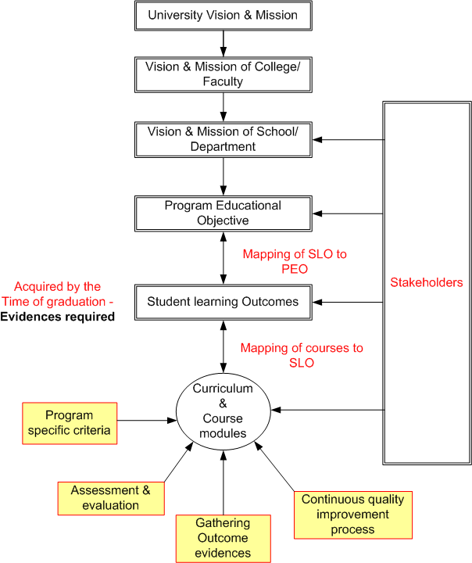

Slide 23
Success of OBE?
William Spady frankly admitted:
  “… “real” OBE is almost impossible for an education system to implement because it requires such profound levels of change – in paradigm thinking, in mission and purpose, in organizational and structural arrangements, in the very meaning teaching and curriculum, in the structuring and use of time, in resource allocations, in professional training, deployment, and support, and in the role of the entire system in its society’s social fabric and economy – that the political, cultural, and economic leaders of a country cannot bring themselves to address the enormity of the task.”

Slide 24
Spady on OBE
“That is why, when asked where one can see “real” OBE in action in education, I say, “Nowhere. But ….”

Slide 25
Spady
Spady, William, Outcome Based Education: Critical Issues and Answers, Arlington, Va, American Association of School Administrators.
Spady, William, It’s Time to End the Decade of Confusion about OBE in South Africa, South African Journal for Science and Technology, https://edulibpretoria.files.wordpress.com/2008/08/spadyobeconfusionpaper.pdf

Slide 26
What is Accreditation?
The process of external quality review used in higher education to scrutinize colleges, universities, and higher education programs for quality assurance and quality improvement.
Success results in an accredited institution and/or program.

Slide 27
Two types of academic accreditation
Institutional accreditation evaluates overall institutional quality, but does not focus on a given academic program.
Program Accreditation evaluates an individual program of study, rather than an institution as a whole. This type of accreditation is granted to a specific program.

Slide 28
Objectives of accreditation (1)
Recognition for professional registration;
Prestige of program being accredited;
International mobility of academic qualifications benchmarked to meet the standards of mutual or international agreements, including the Washington Accord;
Grants, finance and other support for accredited program;

Slide 29
Objectives of accreditation (2)
Transfer of credits between accredited programs
To assist stakeholders as well as potential students and their parents, professional societies, and potential employers, in identifying specific engineering programs that meet the minimum criteria for accreditation;
To provide feedback to the educational institutions for the improvement and development of educational programs.

Slide 30
Accreditation Function
Accreditation is normally voluntary
Accreditation involves:
  an evaluation of engineering education programs offered by the institution, and
  a judgment against stipulated criteria in accordance with the respective accreditation policy and criteria.
An accredited engineering education program is judged as providing satisfactory preparation for graduates to enter the profession in the entry level of engineering practice.

Slide 31
Quality assurance
Accreditation is not a ranking system.
It is an assurance that a program or institution meets established quality standards.
The role of accreditation is to provide periodic external review in support of the program's continuous improvement process.

Slide 32
OBA not OBE
OBA does not require the institutions or the programs to fully embrace the outcome-based education (OBE).
For accreditation purpose, the program shall provide evidences that the set of graduate attributes or student learning outcomes stipulated by the accreditation body are achieved by the students at the time of graduation.
Education providers have freedom to design programs with different detailed structure, learning pathways and modes of delivery.
Outcome-based assessment and evaluation systems must be put in place to verify the achievement of defined program education objectives and graduate attributes.

Slide 33
Outcomes of Significance
The focus of accreditation is on “Outcomes of Significance”
Spady articulated as something that “really mattered in the long run”, long after that particular segment of curriculum or time block was over – something that learners could ultimately “take out the door and apply” …. when they “exited” the system.
That outcomes-of-significance is encapsulated in the set of WA graduate attributes which form the multi-lateral recognition of substantial equivalency of programs within the WA framework.

Slide 34
Perspectives on Program Accreditation
Program Accreditation is a scheme of granting recognition to an education program by an independent body after a systematic and consistent process of evaluating the program in accordance with the stipulated accreditation policy and criteria, and making judgment that the program has satisfied the benchmark standard.
To gain accreditation, first and foremost the program must satisfy the full set of accreditation criteria - to cross the bar.
Continuous quality improvement (CQI) is a necessary criterion, but not the overriding component.

Slide 35
Misleading Interpretation
It is misleading to interpret accreditation as:
  “Accreditation is for continuous improvement of delivery of education for producing human resource needed for national development.”

Slide 36
Proper Perspectives
The narrow focus of accreditation based on continuous improvement has resulted in below-bar programs being granted accreditation just because the programs showed strong efforts in continuous improvement, even without meeting the rigors of the accreditation criteria.
CQI may be a mitigating factor in marginal cases, but must not be taken as the predominant or even over-riding criterion.
CQI is a process, not the outcomes which really matter in the long run – those outcomes students take with them at the exit point of the program.

Slide 37
Challenges to the Education Providers
Faculty have to learn how to set appropriate outcomes for their courses, design OBE curricula, conduct outcomes assessment, and use assessment results for continuous quality improvement.
It takes much time and efforts to learn, to implement and to improve on outcomes assessment.

Slide 38
Acceptance of outcome-based system
Human nature in resisting unfamiliar changes.
Faculty often feels that while outcomes based education is great to have, outcomes based processes are too onerous to implement.
They are upset for having to adapt to new system of planning and managing learning environments and must be committed to valid and reliable assessment.
They are confused on how and at what level students must demonstrate achievement of outcomes.

Slide 39
Acceptance of outcome-based system
There is also the uncertainty of whether fulfilling a passing grade in any educational component implies attainment of outcomes.
They are unclear what a passing grade means in each outcome.
They are still engrossed in grading as the assessment tool and trying to find valid ways of mapping the grading to outcome achievement.
The collection of data to demonstrate the attainment of outcomes is highly time consuming and tedious and often unsustainable

Slide 40
CDIO
The CDIO Initiative is a good example of helping to produce graduate engineers who possess the holistic abilities required at the workplace.
CDIO is based on a commonly shared premise that engineering graduates should be able to: Conceive – Design — Implement — Operate complex value-added engineering systems in a modern team-based engineering environment to create systems and products.

Slide 41
http://www.cdio.org/,
The CDIO™ INITIATIVE
The abilities embodied in the CDIO concept are in alignment with the student learning outcomes in outcome-based engineering education.
In the outcome-based education system, the education system supported by the institution resources is a means to an end in providing the learning experience to ensure that the graduating students are achieving the stipulated learning outcomes.

Slide 42
Conceive
The Conceive stage involves defining customer needs and then developing conceptual, technical and business plans to meet those needs while considering the technology, enterprise strategy, and regulations that apply. This is done in “CDIO” engineering workspaces”.

Slide 43
Design
The Design phase focuses on creating the plans, drawings and algorithms that describe the product, process or system that will be implemented. This is done in “CDIO” engineering workspaces”.

Slide 44
Implement
The Implement stage refers to the transformation of the design into a product.
It includes hardware, manufacturing, software coding, testing and validation.

Slide 45
Operate
The Operate phase used the delivered, implemented product, process or system to satisfy the intended value, that is, to satisfy the customer need.

Slide 46
Part 3:
PEC’s Accreditation Criteria
All the Accreditation Activities are for the purpose of deciding whether the program has satisfied the
9 PEC Accreditation Criteria

Slide 47
PEC Accreditation Criteria
9 criteria in EAB Accreditation Manual
  Program Educational Objectives (PEOs)
  Program Learning Outcomes (PLOs)
  Curriculum and Learning Processes
  Students
  Faculty and Support Staff
  Facilities & Infrastructure
  Institutional Support & Financial Resources
  Continuous Quality Improvement
  Industrial Linkages

Slide 48
Criterion 1 - Program Educational Objectives (PEOs)
Program educational objectives (PEO) are broad statements that describe what graduates are expected to achieve a few years after graduation.

Slide 49
Criterion 1 - Program Educational Objectives (PEOs)
The program seeking accreditation must demonstrate that following are in place:
  a) Well-defined and published Program Mission
  b) Program’s educational objectives defined and consistent with the mission
  c) Program’s educational objectives based on the stakeholder’s needs
  d) A process in place to evaluate the attainment of educational objectives
  e) Evaluation results used for continual improvement of the program

Slide 50
Criterion 2 - Program Learning Outcomes (PLOs)
Program outcomes are the narrower statements that describe what students are expected to know and be able to do by the time of graduation.
These relate to the knowledge, skills and attitude that the students acquire while progressing through the program.
The program must demonstrate that by the time of graduation the students have attained a certain set of knowledge, skills and behavioral traits, at least to some acceptable minimum level

Slide 51
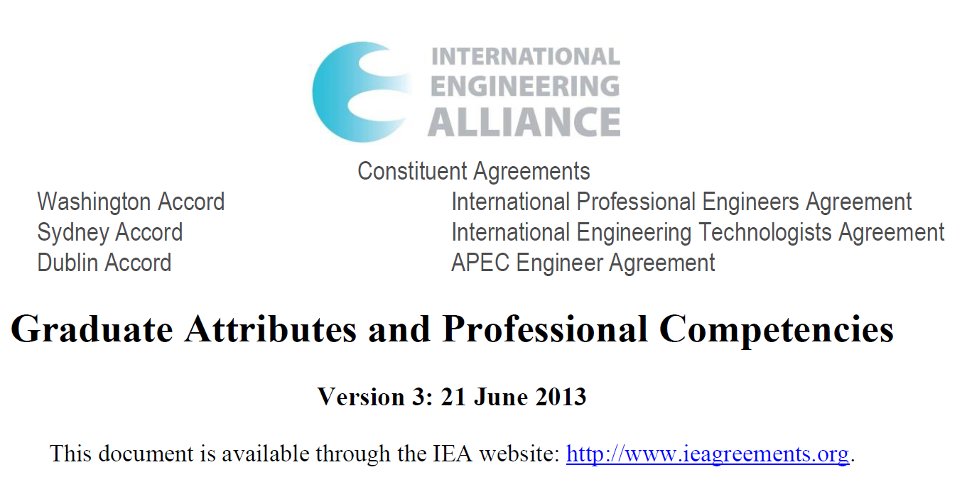
PEC’s 12 PLOs are identical to WA GAs

Slide 52
Graduate Attributes
Graduate attributes form a set of individually assessable outcomes indicative of the graduate's potential competency.
Attributes expected of graduate from an accredited programme - expected capability appropriate to the type of programme.
The graduate attributes are intended to assist outcomes-based accreditation criteria.

Slide 53
PLO #1
Engineering Knowledge:
  An ability to apply knowledge of mathematics, science, engineering fundamentals and an engineering specialization to the solution of complex engineering problems.

Slide 54
PLO #2
Problem Analysis:
  An ability to identify, formulate, research literature, and analyze complex engineering problems reaching substantiated conclusions using first principles of mathematics, natural sciences and engineering sciences.

Slide 55
PLO #3
Design/Development of Solutions:
  An ability to design solutions for complex engineering problems and design systems, components or processes that meet specified needs with appropriate consideration for public health and safety, cultural, societal, and environmental considerations.

Slide 56
PLO #4
Investigation:
  An ability to investigate complex engineering problems in a methodical way including literature survey, design and conduct of experiments, analysis and interpretation of experimental data, and synthesis of information to derive valid conclusions.

Slide 57
PLO #5
Modern Tool Usage:
  An ability to create, select and apply appropriate techniques, resources, and modern engineering and IT tools, including prediction and modeling, to complex engineering activities, with an understanding of the limitations.

Slide 58
PLO #6
The Engineer and Society:
  An ability to apply reasoning informed by contextual knowledge to assess societal, health, safety, legal and cultural issues and the consequent responsibilities relevant to professional engineering practice and solution to complex engineering problems.

Slide 59
PLO #7
Environment and Sustainability:
  An ability to understand the impact of professional engineering solutions in societal and environmental contexts and demonstrate knowledge of and need for sustainable development.

Slide 60
PLO #8
Ethics:
  Apply ethical principles and commit to professional ethics and responsibilities and norms of engineering practice.

Slide 61
PLO #9
Individual and Team Work:
  An ability to work effectively, as an individual or in a team, on multifaceted and /or multidisciplinary settings.

Slide 62
PLO #10
Communication:
  An ability to communicate effectively, orally as well as in writing, on complex engineering activities with the engineering community and with society at large, such as being able to comprehend and write effective reports and design documentation, make effective presentations, and give and receive clear instructions.

Slide 63
PLO #11
Project Management: An ability to demonstrate management skills and apply engineering principles to one’s own work, as a member and/or leader in a team, to manage projects in a multidisciplinary environment.

Slide 64
PLO #12
Lifelong Learning:
  An ability to recognize importance of, and pursue lifelong learning in the broader context of innovation and technological developments.

Slide 65
Complex problems
(A requirement of WA)
Involve wide-ranging or conflicting technical, engineering and other issues
Have no obvious solution and require abstract thinking, originality in analysis to formulate suitable models
Requires research-based knowledge much of which is at, or informed by, the forefront of the professional discipline and which allows a fundamentals-based, first principles analytical approach
Involve infrequently encountered issues
Are outside problems encompassed by standards and codes of practice for professional engineering
Involve diverse groups of stakeholders with widely varying needs
Have significant consequences in a range of contexts
Are high level problems including many component parts or sub-problems

Slide 66
Criterion 3– Curriculum and Learning Process
4-year, 8-semester program.
Minimum Fifteen (15) weeks of teaching, excluding time of examination(s)
The general framework defined by National Curriculum Review Committees (NCRC) of Higher Education Commission (HEC)

Slide 67
Criterion 3– Curriculum and Learning Process
Internship program
Laboratory work
Design projects
Final year project
Assessment of learning outcomes

Slide 68
Assessment of learning outcomes
The program must ensure that each student has achieved all PLOs to acceptable level through assessment of CLOs.
The appropriateness of the assessment methods along with the level of achievement against the targeted outcomes must be evaluated.
Mapping of program outcomes to individual courses, nature of assessment tools (direct/ indirect/rubrics) and the process of evaluation to determine the attainment of PLOs should be demonstrated through reasonably convincing evidences.

Slide 69
Criterion 4 - Students
Admission criteria
Annual intake
Admission response
Transfer of students
Academic counseling
Career and student wellness counseling

Slide 70
Criterion 4 - Students
Class size (theory)
Class size (practical)
Semester academic load
Completion of courses and student feedback
Participation in competition
Student performance evaluation

Slide 71
Student Performance Evaluation
This aspect pertains to the various mechanisms being used for evaluating students’ performance in the program courses, and their suitability and affectivity for assessment of the level of achievement of course learning outcomes.
This may include a review of various class assignments, quizzes, research reports, examinations as well as lab projects and viva-voce.
The number and variety of such assessment tools and their coverage of subject topics in a manner which ensures a reasonably accurate assessment of students’ level of achievement against various learning outcomes is the key to monitor students’ progress in a direct manner.
It is expected that the program should demonstrate a minimum number of such class assignments, quizzes and examinations for assessment of PLOs.

Slide 72
Criterion 5–Faculty and Support Staff
Faculty strength
Full-time dedicated faculty
Shared faculty
Visiting faculty
Faculty qualifications
Student/faculty ratio

Slide 73
Criterion 5–Faculty and Support Staff
Faculty training & mentoring
Faculty Retention, Development and Career Planning
Pyramid of Academic Structure
Faculty workload
Faculty Research & Publications

Slide 74
Criterion 6–Facilities and Infrastructure
adequacy of teaching and learning facilities such as classrooms, learning-support facilities, study areas, information resources (library), computing and information-technology systems, laboratories, workshops, and associated equipment to cater for multi-delivery modes.
adequacy of support facilities such as hostels, sports and recreational centers, health care centers, student centers, and transport in facilitating students’ life on campus and enhancing character building.

Slide 75
Criterion 7–Institutional Support and Financial Resources
Financial resources and their commitment to support an engineering program.
Adequacy of these resources in sustaining the program, with a view to its up-gradation and future enhancements

Slide 76
Criterion 8–Continuous Quality Improvement
Has a proficient closed-loop system is in place.
has well defined process for quality improvement
provides steps taken for improvement of program quality, particularly in the light of the observations of last accreditation visit.
provides information and reports that are prepared for continuous quality improvement related to different accreditation criteria

Slide 77
Criterion 9–Industrial Linkages
Opportunity to students for training, consultancy, R&D and exposure to professional practices.
Students are expected to undertake assignments from industry to provide solutions to complex engineering problems.
Students and faculty encouraged to establish collaboration for R&D and product development related projects, with due regard to environmental and societal impact.
Feedback from the industry and employers is crucial and an essential part of curriculum review process used to evaluate attainment of the program objectives.

Slide 78
Part 4
Preparing New Program for Accreditation

Slide 79
Step 1 – Decide to go for accreditation
Top management of HEI involved
Initiated by Program Director, HoD
Support of President, VC, Provost, Dean

Slide 80
Step 2 – Establish a Program Accreditation Committee
Program Director
Representatives of senior and junior faculty members whose contribution in accreditation should be recognized
Desirable attributes for selecting committee members
  Hardworking
  Willing to learn new things
  Not calculating

Slide 81
Step 3 – Understand PEC accreditation requirements
Program accreditation committee studies thoroughly PEC requirements for accreditation
  Manual of Accreditation
  Accreditation Policy
  Accreditation Process
  Criteria for Accreditation
Consult PEC for clarification and further information

Slide 82
Step 4 – Examine details of accreditation criteria
Program Accreditation Committee studies the detailed requirements of each criteria
Conduct gap analysis of requirements and current state, and what need to be done to close the gaps

Slide 83
Step 5 – Confirm to go for accreditation or just drop the idea
Based on evaluation of gap analysis of step 4, a decision is made to prepare the program for accreditation
Top management of HEI involved

Slide 84
Step 6 – Establish strategy and roadmap
Program Accreditation Committee established strategy and roadmap for the program to be accredited
Resources and commitments from top management

Slide 85
Step 7 – Sharing of strategy and roadmap with stakeholders
Explain the reasons to go for accreditation
Sell the importance and benefits of accreditation to the stakeholders
Buy-in from faculty members – whom will be actively involved
Explain the resources and help which will be provided

Slide 86
Step 8 – Project Execution and Management
Establish timeline for achieving each milestone
Assign capable people in charge of each activities
Bring in all stakeholders early
Regular sharing and checking on progress

Slide 87
Step 9 – Training & Training
Provide overview of accreditation to all faculty, management and supporting staff
Conduct seminar on requirements of outcome-based accreditation, and the requirements of PEC accreditation criteria
Conduct workshop on assessment of PLOs
Establish tools, assessment methodologies, templates to assist outcomes assessment

Slide 88
Step 10 – Active Participation of Stakeholders
Establish Program Advisory Committee with participation of diverse stakeholders, particularly from the industry and professionals
Involve stakeholders in framing the Program Education Objectives
Involve stakeholders in examining the curriculum and student learning activities

Slide 89
Step 11 – Continuous Quality Improvement
Establish & implement the close-loop CQI process
Adopt period review with stakeholders
Take necessary remedial actions
Overcoming barriers and objections

Slide 90
Continuous Quality Improvement Process in Outcome-based Accreditation
Other feedback mechanisms
Institution Resources, Teaching & Learning Environment
Stake-holders
PEO
SLO
SLO Delivered
SLO
Curriculum & Course Modules
Other Curricular & Extra- Curricular Activities
SLO
Graduates
Working
In
industry
Course Module 2
Individual Course
Learning
Outcomes
1
Course Assessment & Evaluation by Course Lecturer
Institution Vision & Mission
SLO
Course Module 1
1
Course Assessment & Evaluation by Course Lecturer
2
SLO Assessment & Evaluation by
Management/Accreditation Committee
3
PEO Assessment & Evaluation
(Surveys, Interviews, etc) by
Management/Accreditation Committee
Continuous Quality Improvement

Slide 91
Step 12 – PEO and PLO Evaluation
Assessment and evaluation of achievement of PEO
  Employers survey
  Alumni feedbacks
  Other means
Assessment and evaluation of attainment of PLOs
  Compilation of folders for each outcomes
  Outcomes assessment at course level

Slide 92
Step 13 – Preparation of
Self-Assessment Report
This is a live document which is updated periodically
Advantageous to prepare SAR early, well before applying to PEC for accreditation visit
The exercise is valuable to identify gaps which need to be addressed.

Slide 93
Step 14 – Apply to PEC for Accreditation
Apply to PEC when self-evaluation indicates that the program is ready for accreditation
Decision to apply for PEC accreditation should be agreed upon and shared with all faculty and management at program/departmental meeting

Slide 94
Step 15 – Prepare for Accreditation Visit
Establish timelines/schedule with PEC
  Constraints of availability of institution’s top management
Prepare and submit the SAR
Get ready documents for on-site examination by visiting team
  Folders with evidences of outcomes
  Others as mentioned in Accreditation Manual or requested by visiting team

Slide 95
Step 16 – Logistics for Accreditation Visit
Take time and efforts to finalize the logistics
Get those involved all well-prepared
Realistic schedule and timing
Presentations should not repeat what are already included in SAR
Minimize time for facilities inspection
Meetings with stakeholders – arranged for focused groups

Slide 96
Part 5
Sharing of Some Common Shortcomings

Slide 97
1. Poorly prepared SAR
Not preparing ahead – last-minute chasing of information
Not following the PEC template, resulting in many missing information
Errors and inconsistencies – lack of review and proofreading
Inadequate information required
Poor 1st impression

Slide 98
2. Lack of understanding of OBA
Program director and faculty did not have fundamental appreciation of the requirements of outcome-based accreditation
No knowledge of terms used, e.g. PEO, PLO (SLO)
Mix up of PEO and PLO in SAR
Faculty not conducting outcomes assessment

Slide 99
Key features of OBA
OBA focuses more on:
  Learning, as against teaching
  Students
  Outcomes, not inputs or capacity
OBA incorporates continuous improvement
  to systematically analyze its systems for variance
  make decisions based on facts
  consciously define the organization’s customers – both internal and external
  actively seek input from customers

Slide 100
Outcomes-based system
The emphasis is on measured “outcomes” rather than "inputs”
Outcomes include a range of skills and knowledge
Outcomes are measurable, observable
Outcomes (skills and knowledge) are specified, but not inputs
Identifying appropriate and measurable outcomes is difficult, and often controversial

Slide 101
Outcomes
Stipulate knowledge, skills, attitudes & behaviors on completion of program
Well documented
Defined by measurable performance indicators
Both direct & indirect assessment tools to measure each outcome

Slide 102
Writing Intended Learning Outcomes
Intended learning outcomes need to be written at both programme and course levels.
Both of them need two essential elements:
  A statement of what content are the students expected to be able to do at the end of learning experience;
  The levels of understanding or performance in those content areas.

Slide 103
Definition of terms used
Programme Educational Objectives
  Programme educational objectives are broad statements that describe the career and professional accomplishments that the programme is preparing graduates to achieve (within 3 to 5 years after graduation)
Student Learning Outcomes
  Student learning outcomes are narrower statements that describe what students are expected to know and be able to do by the time of graduation. These relate to the skills, knowledge, and behaviours that students acquire in their matriculation through the programme

Slide 104
3. Lack of understanding of PEO
PEO written in the form of PLO
  e.g. students will be able to do ….

Slide 105
Alignment with Mission
University mission?
Faculty (school) mission & departmental mission statement?
Alignment with mission of institution?
Published and known to stake-holders?

Slide 106
Programme Education Objectives (PEO)
Broad statements that describe what graduates are expected to attain within a few years after graduation
Align with university’s & engineering school’s mission
Well defined & documented & publicized
Stakeholders’ participation, including faculty
Manageable number of objectives
Define outcomes
Measurable
Feedback mechanism for improvement

Slide 107
Programme Educational Objective (PEO)
PEO consistent with mission?
Alignment with mission of institution?
Published and known to stake-holders?
Based on needs of constituencies?
Curriculum and processes that lead to attainment of PEO?
Common mistakes in setting PEO
  Too broad and not specific to program
  Too narrow and similar to SLO
  Not known to stake-holders

Slide 108
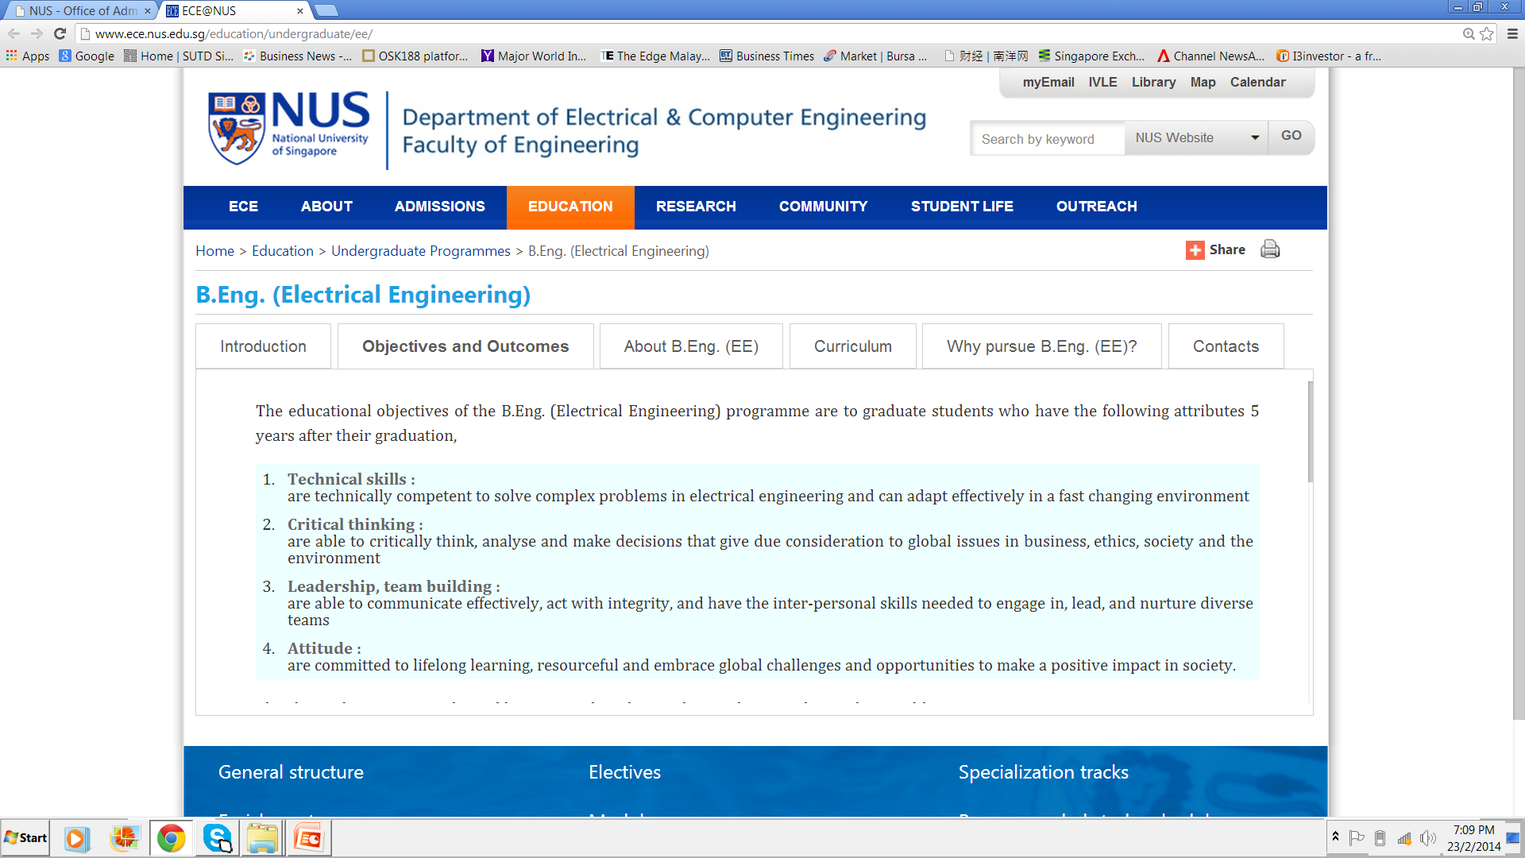

Slide 109
Achievement of PEO
Are assessment and evaluation processes in place to determine attainment of PEO?
Is there a continuous improvement mechanism in place?
Evidence and documentation is important.

Slide 110
Assessment of Programme Educational Objectives
What graduates are expected to attain within a few years after graduation
Ingredients to look out for:
  Objectives are current and relevant
  Methods and frequency to monitor if they are appropriate (usually every 2 to 3 yrs)
  Constituents involved is appropriate
  Student learning outcomes will enable its attainment
  Effective assessment processes in place to evaluate achievement
  Assessment method depends on factors like size of cohorts
  Methods can include data from advisory boards, recruiters, employers, graduate surveys

Slide 111
4. PLOs not well matched
PLOs are not “perfect” match to those stipulated by the accreditation body
Difficult to evaluate the shortfalls in breadth and depth of outcomes achievement
My suggestion
  Adopt all 12 PEC PLOs without changes
  Add additional PLOs if you want (but bear in mind the additional work in assessment, and the curriculum support)

Slide 112
5. Lack of Outcomes Assessment
Only mapping of courses to outcomes
No outcomes assessment at course level
Faculty not trained and are not conducting outcomes assessment
Subject/course marks & grading used as justification that overall outcomes are contributed by the subject(s)

Slide 113
Student Learning Outcomes
Student learning outcomes describe what students are expected to know and able to do by the time of graduation
These relate to knowledge, skills, and behaviors that student acquire as they progress through the program
Student learning outcomes to be stated and documented - in the form of graduate attributes
Provide mapping of program SLO with EAB’s SLO, if different
Relationship of SLO to PEO

Slide 114
Table 2.1 : Mapping of Student Learning Outcomes to graduate attributes
in EAB’s Criterion 2(i) (a) to (j)
Educational institution’s Student Learning Outcomes [if different from graduate attributes in Criterion 2(i) (a) to (j)] |  | Graduate attributes in EAB’s 2(i) (a) to (j)*
(1) | Student learning outcome (..)
(2) | Student learning outcome (…)
(3) | |
(4) | |

Slide 115
Assessment of Student Learning Outcomes
Collect data to assess the level students have attained outcomes
Evaluate results to assist in deciding how to improve teaching-learning processes
Key features to take note:
  Assess performance of cohorts, not individual students
  For each outcomes, identify key performance indicators@ (concrete actions students is able to perform)
  Not necessary to collect data for every student in every course – data collection needs to be representative
  Not necessary to have more than one data point to determine performance of an outcome
  Not necessary to assess every outcome every year
  Focus is on how data is used to understand strengths/weaknesses and continuous improvement
  @ Definition by ABET: Specific, measurable statements identifying the performance(s) required to meet the outcome; confirmable through evidence

Slide 116
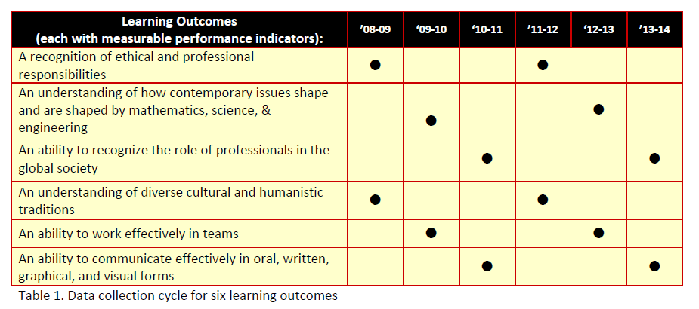
Reference (from ABET)
In program assessment planning, it is important to let common sense prevail. Example of how not having to assess every outcome every year:

Slide 117
Course Learning outcomes
Course Learning Outcomes describe what a student should be capable of as a result of learning experiences within a course
To be determined by the course instructor (s)
Mapping course learning outcomes to SLO to show learning experience meets the accreditation criteria
Each course may contribute to a list of SLOs, may contribute strongly to one or some SLOs and less strongly to other SLOs
When a course may contribute to several SLOs, usually only a subset of its strong outcomes need to be used for EAB assessment

Slide 118
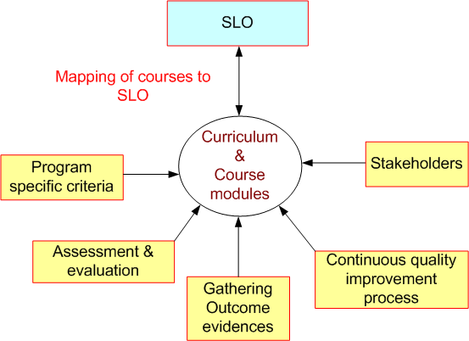

Slide 119
Defining Curriculum Objective and Intended Course Learning Outcomes
A learning outcome is what a student can do as a result of a learning experience.
It describes a specific task that student is able to perform at a given level of competence under a certain situation.
The three broad types of learning outcomes are:
  Disciplinary knowledge and skills
  Generic skills
  Attitudes and values

Slide 120
Table 3.1: Curriculum and teaching processes to achieve Student Learning Outcomes,
and evaluation method/criteria
Module | Category# | Evaluation method & criteria | Student Learning Outcomes*
 |  |  | (1) | (2) | (3) | (4) | (5) | (6) | (7) | --

Slide 121
Course Learning outcomes
Course Learning Outcomes describe the complex performances a student should be capable of as a result of learning experiences within a course.
These are determined by the course instructor (s)
Mapping course learning outcomes to program outcomes and how overall learning experience meet the accreditation criteria

Slide 122
Contribution of each course
Each undergraduate course in the department contributes to a list of SLOs.
Usually, a course may contribute strongly to some EAB* SL outcomes and less strongly to other outcomes.
While a course may contribute to several NBA SLOs, usually only a subset of its strong outcomes need to be used for EAB* assessment.
*Adapted from: UCLA Electrical Engineering Department’s “Guide for instructors and teaching
Assistants of undergraduate courses

Slide 123
Teaching-Learning Processes
Each program should cover general and specialized professional content
Adequate breadth and depth, and
Appropriate components in Science and Humanities
Evaluation of teaching-learning processes
Modes of teaching-learning: lecture, tutorial, seminar, projects, internship, peer-group discussion, ..

Slide 124
6. Mapping exercise
Program Accreditation Committee undertake the task of mapping subjects/courses to each outcomes
Faculty teaching a particular subject is not aware of the outcomes contribution from his subject, and has not conducted proper outcomes assessment
Just a mapping exercise – not acceptable

Slide 125
7. Faculty not fully involved in outcomes assessment
Most faculty members do not understand outcome-based accreditation
They are not trained in outcomes assessment
They don’t know how to conduct proper outcomes assessment
Student learning activities not guided by outcomes
They rely on marks and grades to justify course outcomes attainment

Slide 126
8. Obsession with Assessment
Assessment involves:
  Cognitive domain (thinking, knowledge)
  Psychomotor domain (doing, skills)
  Affective domain (feeling & attitude)
Is the assessment efforts sustainable?

Slide 127
Bloom’s Taxonomy – Cognitive Domain
(modified by Anderson & Krathwohl)
Creation
Evaluation
Compare, decide …
Synthesis
Design …
Analysis
Analyse …
Application
Calculate …
Comprehension
Explain …
Knowledge (Remembering)
List …

Slide 128
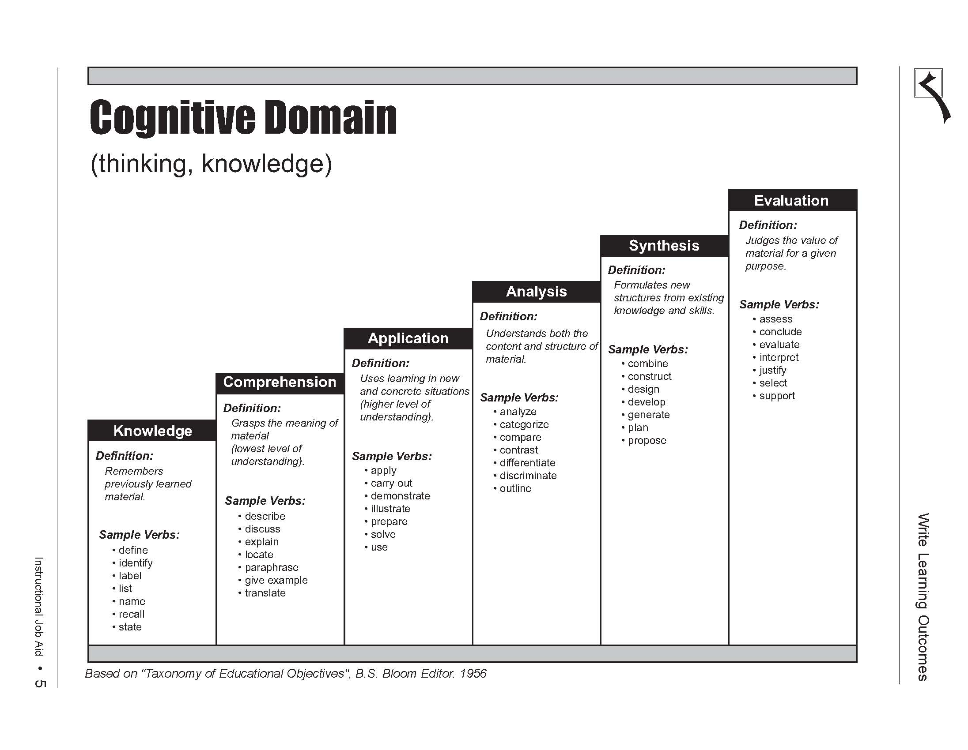
Prof Megat’s slide taken from PEC website
lower order
Intermediate
Higher order

Slide 129
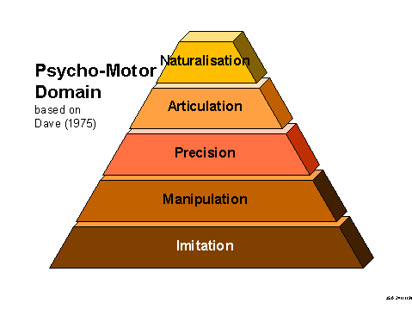
Psychomotor Domain
http://www.learningandteaching.info/learning/bloomtax.htm

Slide 130
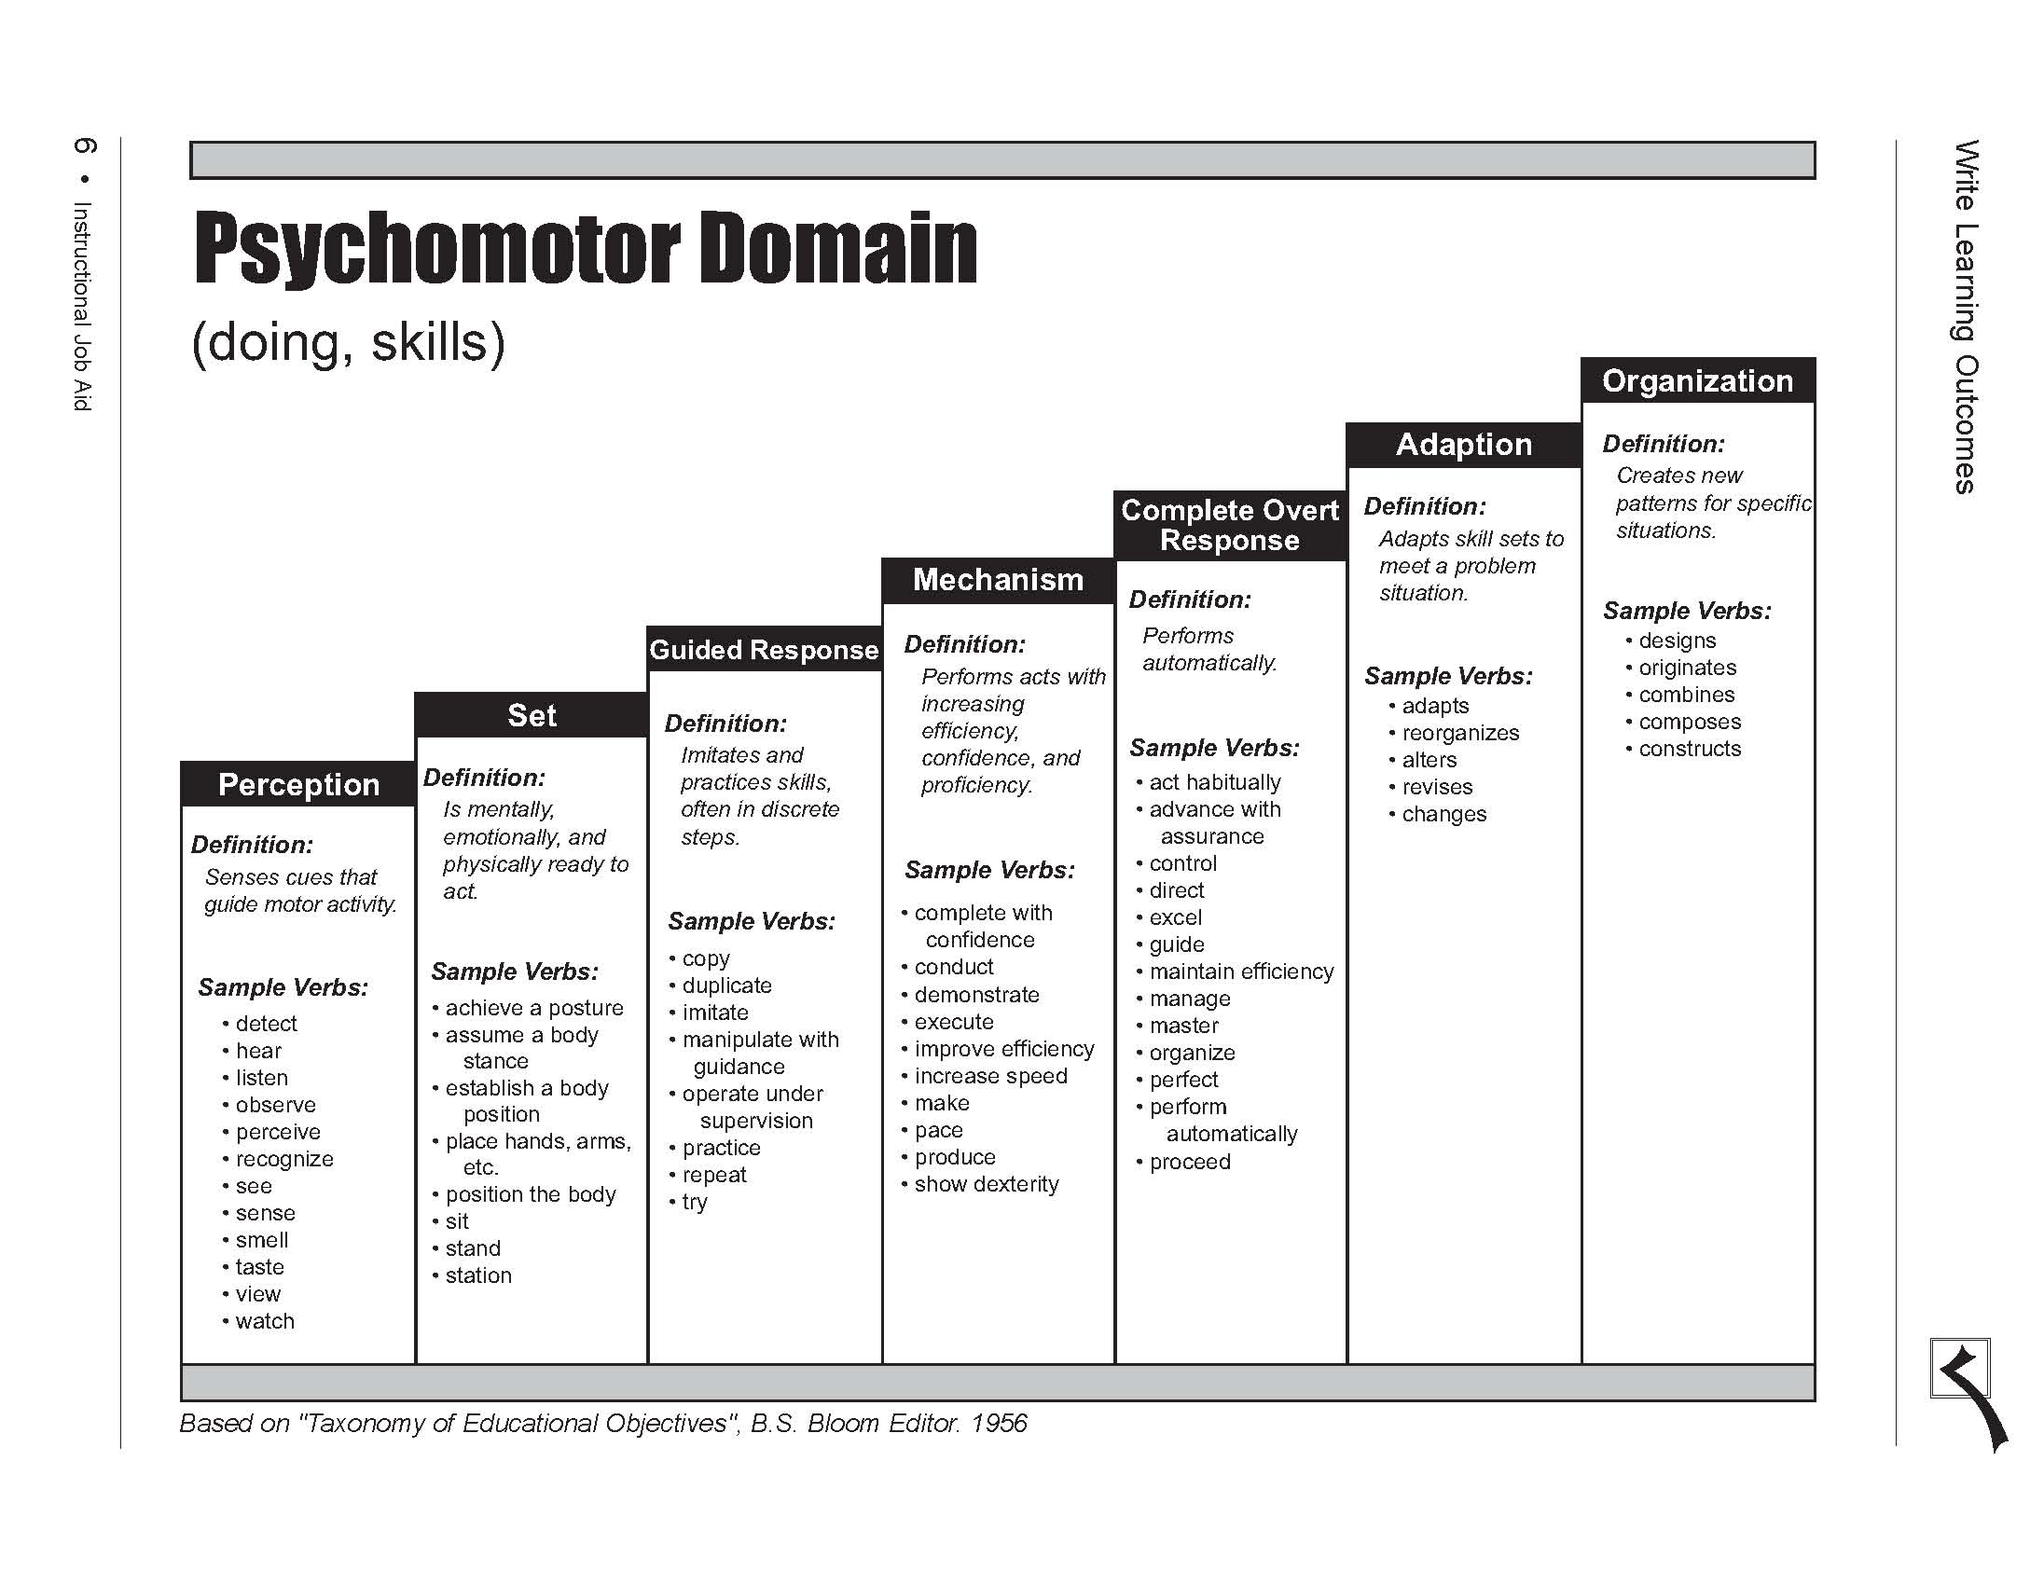
Prof Megat’s slide taken from PEC website
lower order
Intermediate
Higher order

Slide 131
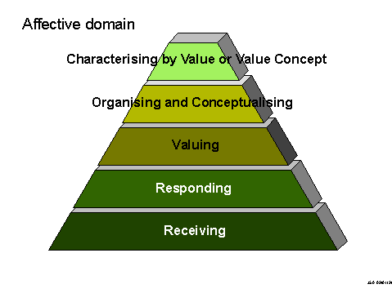
Affective Domain
http://www.learningandteaching.info/learning/bloomtax.htm

Slide 132
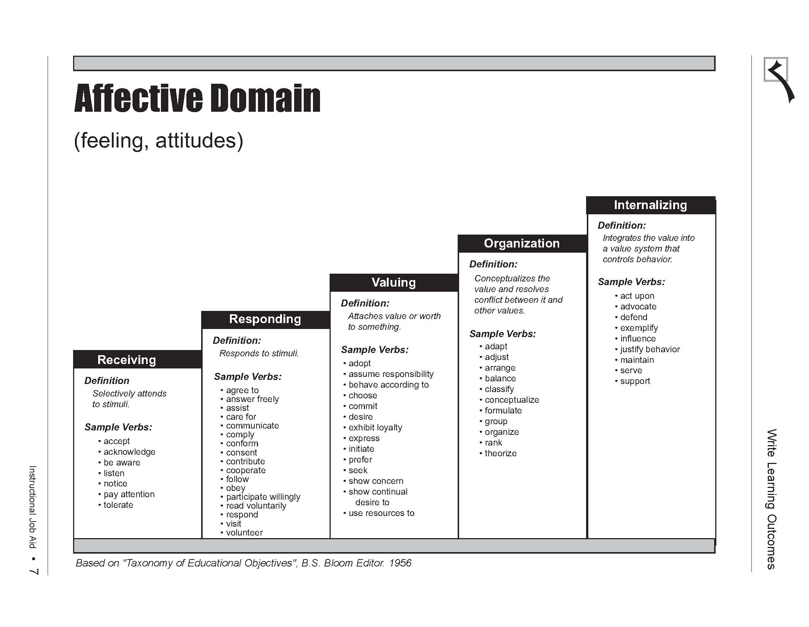
Prof Megat’s slide taken from PEC website

Slide 133
9. Wrong Justification of Outcomes Attainment
Wrong interpretation of the Bloom’s Taxonomy
Entry level courses are used to map achievement of outcomes at mastery level simply because some assessment exercises include activities of
  Write
  Evaluate
  Design, etc
Note that Complex Engineering Problems should be used for assessment at masterly level

Slide 134
Abilities
Knowledge (gathering & recall)
Comprehending information
Application (making use of knowledge)
Analysis (taking apart)
Synthesis (putting together)
Evaluation (judging the outcome)
Creation

Slide 135
Activities | Action Verbs that provides evidence
Knowing | define, describe, identify, label, name, outline, reproduce, recall, select, state, present, be aware of, extract, organise, recount, write, recognise, measure, underline, repeat, relate, know, match.
Comprehension | interpret, translate, estimate, justify, comprehend, convert, clarity, defend, distinguish, estimate, explain, extend, generalise, exemplify, give examples of, infer, paraphrase, predict, rewrite, summarise, discuss, perform, report, present, restate, identify, illustrate, indicate, find, select, understand, represent, name, formulate, judge, contrast, translate, classify, express, compare.
Application of knowledge (understanding) | apply, solve, construct, demonstrate, change, compute, discover, manipulate, modify, operate, predict, prepare, produce, relate, show, use, give examples, exemplify, draw (up), select, explain how, find, choose, assess, practice, operate, illustrate, verify.
Analysis | recognise, distinguish between, evaluate, analyse, break down, differentiate, identify, illustrate how, infer, outline, point out, relate, select, separate, divide/subdivide, compare, contrast, justify, resolve, devote, examine, conclude, criticise, question, diagnose, identify, categorise, point out, elucidate.
Synthesis | propose, present, structure, integrate, formulate, teach, develop, combine, compile, compose, create, devise, design, explain, generate, modify, organise, plan, rearrange, reconstruct, relate, reorganise, revise, write, summarise, tell, account for, restate, report, alter, argue, order, select, manage, generalise, precise, derive, conclude, build up, engender, synthesise, put together, suggest, enlarge.
Evaluation | Judge, appraise, assess, conclude, compare, contrast, describe how, criticise, discriminate, justify, defend, evaluate, rate, determine, criticise, choose, value, question.

Slide 136
Ability/ competency | Level | Definition
Knowledge | 1 | the remembering of previously learned material; it may involve the recall of a wide range of material from specific facts to complete theories, but all that is required is the bringing to mind of the appropriate information.
Comprehension | 2 | the ability to grasp the meaning of material; may be shown by translating material from one form to another (words to numbers), by interpreting material (explaining or summarizing), and by estimating future trends (predicting consequences or effects); this goes one step beyond the simple remembering of material, and represent the lowest level of understanding
Application | 3 | the ability to use learned material in new, concrete situations; may include the application of rules, methods, concepts, principles, laws, and theories; requires a higher level of understanding than those under comprehension.
Analysis | 4 | the ability to break down material into its component parts so that its organizational structure may be understood; may include the identification of parts, analysis of the relationship between parts, and recognition of the organizational principles involved; represents a higher level than comprehension and application because it requires an understanding of both the content and the structural form of the material.
Synthesis | 5 | the ability to put parts together to form a new whole; may involve the production of a unique communication, a plan of operations (research proposal), or a set of abstract relations (scheme for classifying information); stresses creative behaviors, with major emphasis on the formulation of new patterns or structure
Evaluation | 6 | the ability to judge the value of material for a given purpose, based on definite criteria; contains elements of all the other categories, plus conscious value judgments based on clearly defined criteria.
Creation | 7

Slide 137
10. Curriculum not adequate to support all the 12 outcomes
Curriculum not adequately structured to achieve all the 12 PLOs
Common curriculum deficiencies
  The engineer and society
  Environment and sustainability
  Ethics
  Finance and project management

Slide 138
Curriculum
Does the curriculum satisfy the program specific criteria of the particular engineering discipline?
Are performance indicators established to measure the outcomes of the courses with respect to the program outcomes of NBA criteria)?
Major design experience?
Prerequisites
Course syllabi
Cores and electives

Slide 139
11. Industry stakeholder not adequately involved
No Program Advisory Committee (PAC) with industry members
Industry not involved in setting PEO and curriculum review
PAC not active – meeting once in many years
No proper minutes of PAC meeting for deliberation of academic matters (PEO, PLO, student learning activities)

Slide 140
Interaction between institution & industry
Involvement of industry stake-holders to ensure relevance of curriculum
Opportunity for students to acquire industrial experience via internships and design projects by professional engineers and faculty members with industrial experience
Communication channel with industry, e.g. industry advisory board

Slide 141
12. Health and Safety Issues
Health & safety issues affect attainment of full accreditation
Many of the H&S issues could have easily been addressed
Common H&S issues
  General on-campus safety
  Laboratory safety
  Electrical safety
  Chemical safety
  Others

Slide 142
13. Inadequate evidences to demonstrate compliance with criteria
Not enough work done to gather evidences to demonstrate compliance with criteria
Best practices
  Course folders
  Folders for each outcomes
  Samples of student portfolio

Slide 143
Saving Samples of Student Works
Each course is required to save samples of student homework solutions, laboratory reports, project or design reports, and exam solutions, typically from poor to good quality.
At the end of each quarter, the lecturers of all undergraduate courses must compile a binder containing in addition to the solutions, the corresponding homework questions, exam questions, lab description, and project description.

Slide 144
14. Poor Execution of logistics during on-campus visit
Lack of planning and experience
Lack of commitments and support
Not knowing what the visiting team will focus on

Slide 145
What the PEV looks for?
PEVs are sent to evaluate programs, certifying that they satisfy the criteria
They look for evidences that the required criteria are met
They identify deficiencies, weaknesses, concerns
They are not advisers and should not give solutions to problems identified

Slide 146
Major focus
Outcome of the education provided;
Quality assurance processes, including internal review;
Assessment procedures;
Activities and work of the students;
Entry standards and selection procedure for admission of students;
Motivation and enthusiasm of faculty;
Qualifications and activities of faculty;
Facilities;
Industry participation.

Slide 147
Part 6
Discussion on
Outcomes Assessment

Slide 148
Definition of terms used
Assessment
  Assessment is one or more processes that identify, collect, and prepare data to evaluate the achievement of programme educational objectives and student learning outcomes
Evaluation
  Evaluation is one or more processes for interpreting the data and evidence accumulated through assessment practices. Evaluation determines the extent to which programme educational objectives or student learning outcomes are being achieved, and results in decisions and actions to improve the programme

Slide 149
Assessment
&
Demonstration of Achievement
Breadth
Depth
Where gained
Learning Process
Assessment Methods

Slide 150
Demonstration of Achievement of PLOs to PEC Requirements
Reference: Designing Better Engineering Education Through Assessment
by JE Spurlin, SA Rajala & JP Lavelle
Stylus Publishing LLC, 2008

Slide 151
We Have To
Demonstrate that students have achieved the specified learning outcomes at appropriate level by the time of graduation, and
Provide evidence that our program has contributed to our students’ ability to achieve the PLOs

Slide 152
Assessment of PLO – Where?
Course work & curricular activities
  Classes chosen, major
Classroom experience
  Pedagogy, facilities, faculty & student interaction,
Out-of-class experience
  Co-curricular, internships, support services

Slide 153
1. Engineering Knowledge
Apply knowledge of mathematics, science, engineering fundamentals and an engineering specialization to the solution of complex engineering* problems.

Slide 154
Assessment of PLO (1)
“Apply” - Level 3 BT
Demonstrate breadth and depth of education and type of knowledge, both theoretical and practical
Show students can employ general principles, theories, concepts, and/or formulas from mathematics, science, and engineering in the solution of problems in their field of engineering.
For a particular complex engineering problem, students should demonstrate that they can
  Define and describe the pertinent principle, theory, concept, and/or formula,
  Explain why it is appropriate to the problem, and
  Demonstrate how it has been applied in the solution of the problem.
  Best demonstrated via capstone project or design work

Slide 155
Assessment of PLO (1)
Show evidence that students required to take modules in mathematic and science
Respond positively, after students have been on the job, in applying knowledge of mathematics, science, and engineering to the particular engineering problems they encountered at work;
Achieve a positive rating from their employers regarding their ability to apply general principles of mathematics, science, and engineering to particular engineering situations.

Slide 156
2. Problem Analysis
Identify, formulate, research literature and analyse complex engineering problems reaching substantiated conclusions using first principles of mathematics, natural sciences and engineering sciences.

Slide 157
Assessment of PLO (2)
Identify – level 2 BT
Formulate – level 3 BT
Research – level 3 BT
Analyse, Solve – level 4 BT
reaching substantiated conclusions – level 6 BT
Demonstrate complexity of analysis
Show that students can identify engineering problems. Problem identification entails two procedures:
  Ability to recognize an engineering problem. An engineering problem is an opportunity for change in which engineering solutions can be applied to improve on existing or anticipated conditions and
  Ability to define an engineering problem. Defining a problem means describing, in concrete and specific terms, the existing or anticipated condition that creates the opportunity for change and the goal state(s) that provides the direction and end-point for change

Slide 158
Assessment of PLO (2)
Show that they have taken assignment and project work and have the ability to research through relevant literature review
Show that they can represent a problem in a form that makes finding solutions more efficient and effective.
Show that they can analyze problems, that is, isolate and describe the important components of a problem; what is given (design specifications, availability of materials, performance requirements, testing standards, etc); what is known from previous experience relevant to the problem; and what the unknown are;

Slide 159
Assessment of PLO (2)
Show that they can apply engineering principles and mathematics to find the unknowns and arrive at appropriate solutions to the problem;
Show that they are able to reach substantiated conclusions based on an analysis of various relevant factors
Respond positively, after they have been on the job, to the training and guidance they received in solving engineering problems;
Achieve a positive rating from their employers regarding their ability to solve engineering problems.

Slide 160
3. Design / Development of Solutions
Design solutions for complex engineering problems and design systems, components or processes that meet specified needs with appropriate consideration for public health and safety, cultural, societal, and environmental considerations.

Slide 161
Assessment of PLO (3)
Level 5 of BT
Demonstrate breadth and uniqueness of engineering problems, i.e. extent to which problems are original and to which solutions have previously been identified or codified
Show, via capstone project or design assignments, that students can engage productively and creatively in the process of design.
  Establishing the goal of the design project, the outcome that must be attained
  Defining the project
  Take account of public health and safety, cultural, societal, and environmental considerations
  Brainstorming for alternative possibilities
  Choosing the best of the possible solutions
  Creating a prototype or model that embodies or represents the chosen solution
  Testing the prototype or model against the criteria for the project, and
  Choosing and justifying to an appropriate audience the final system, component, or process

Slide 162
Assessment of PLO (3)
Provide evidence that curriculum covers public health and safety, cultural, societal, and environmental issues
Respond positively, after they have been on the job, to the training and guidance in design process they received at university
Achieve a positive rating from their employers regarding their ability to engage productively and creatively in the process of design

Slide 163
Assessment of PLO
Assessment is big subject and probably the major challenge of the teaching faculty
Are assessment methods adequate to provide evidence of achievement of PLO?
Each learning outcome may be measured or evaluated in terms of performance indicators
Is there a system in place to ensure that each student will acquire the stated PLO before graduation? (bearing in mind the various core and optional subjects available, and overseas attachment)

Slide 164
Sustainable Program Assessment Processes
Direct and indirect methods of assessment to be applied to measure a wide variety of different student abilities
Consider best fit between program needs, satisfactory validity and affordability (time, money and effort)
Need to use multiple methods to maximise validity and reduce bias of any approach – triangulation.

Slide 165
Assessment
Assessment is one or more processes that identify, collect, and prepare data to evaluate the attainment of student learning outcomes and program educational objectives.
Effective assessment uses relevant direct, indirect, quantitative and qualitative measures as appropriate to the objective or outcome being measured.
Appropriate sampling method may be used as part of an assessment process.

Slide 166
Steps for assessment design
Define results to be measured
Identify data required and sources
Review existing assessment method
Define additional methods and measures
Implement & evaluate

Slide 167
SUTD
Example of assessment for Capstone Project

Slide 168
Assessment Methods
(Gloria Rogers)
Locally developed examinations
Oral exam
Written surveys and questionnaires
Commercial, norm-referenced, standardized exams
Exit and other interview
Focus groups
External examiner
Portfolios
Simulations
Performance appraisals
…

Slide 169
Examples of Assessment Methods in EC UK
Exams
Class tests
Project reports
Presentations
Lab reports
Design studies
Vivas/orals
Posters

Slide 170
Assessment tools and methods
Formative assessment
The collection of information about student learning during the progression of a course or program in order to improve students learning. Example: reading the first lab reports of a class to assess whether some or all students in the group need a lesson on how to make them succinct and informative.

Slide 171
Assessment tools and methods
Summative assessment
The gathering of information at the conclusion of a course, program, or undergraduate career to improve learning or to meet accountability demands. When used for improvement, impacts the next cohort of students taking the course or program. Examples: examining student final exams in a course to see if certain specific areas of the curriculum were understood less well than others; analyzing senior projects for the ability to integrate across disciplines.

Slide 172
Rubric
A rubric is a set of criteria for assessing student work or performance. Rubrics are particularly suited to learning outcomes that are complex or not easily quantifiable, for which there are no clear “right” or “wrong” answers, or which are not evaluated with standardized tests or surveys. Assessment of writing, oral communication, critical thinking, or information literacy often requires rubrics.

Slide 173
Evaluation
Evaluation is one or more processes for interpreting the data and evidence accumulated through assessment processes.
Evaluation determines the extent to which student outcomes and program educational objectives are being attained.
Evaluation results in decisions and actions regarding program improvement.

Slide 174
Two Assessment Mechanisms
The End-of-Course Instructor Survey and
The Instructor Evaluation of Students’ Performance on an EAB*-related Problem
  It is the main mechanism used to obtain instructor feedback on whether the students in the course achieved some of the desired course outcomes.
Adapted from: UCLA Electrical Engineering Department’s “Guide for instructors and teaching
Assistants of undergraduate courses

Slide 175
Student Survey
End-of-Course Student Surveys.
The Student Surveys collect student input on course material, course organization, and instruction.
Besides asking students questions about the quality of a course and its instruction, the surveys also assess, for each course, the main topics that students are expected to have been exposed to during the course.
Adapted from: UCLA Electrical Engineering Department’s “Guide for instructors and teaching
Assistants of undergraduate courses

Slide 176
Student Survey
Students are asked to rate, on a scale from Poor to Excellent, whether they feel they have had an opportunity to learn the Specific Course Outcomes well.
The student input is then summarized and tracked in:
  1. Individual reports on Course Performance for each course offering.
  2. Yearly reports on Course Performance during an academic year.
  3. Quarterly reports on Department Performance.
  4. Yearly reports on Department Performance.
Adapted from: UCLA Electrical Engineering Department’s “Guide for instructors and teaching
Assistants of undergraduate courses

Slide 177
Other student feedback mechanisms
Student feedback may be collected through two additional mechanisms:
  Exit surveys administered to graduating seniors.
  Student Advisory Committee.

Slide 178
Saving Samples of Student Works
Each course is required to save samples of student homework solutions, laboratory reports, project or design reports, and exam solutions, typically from poor to good quality.
At the end of each quarter, the lecturers of all undergraduate courses must compile a binder containing in addition to the solutions, the corresponding homework questions, exam questions, lab description, and project description.

Slide 179
Student Learning Outcomes
Student learning outcomes to be stated and documented - in the form of graduate attributes
Provide mapping of program PLO with EAB’s PLO, if different
Relationship of PLO to PEO

Slide 180
Assessment of PLO
Assessment is big subject and probably the major challenge of the teaching faculty
Are assessment methods adequate to provide evidence of achievement of PLO?
Each learning outcome may be measured or evaluated in terms of performance indicators
Is there a system in place to ensure that each student will acquire the stated PLO before graduation? (bearing in mind the various core and optional subjects available, and overseas attachment)

Slide 181
Program Outcomes & Teaching-Learning Processes
Each program should cover general and specialized professional content
Adequate breadth and depth, and
Appropriate components in Science and Humanities
Evaluation of teaching-learning processes
Modes of teaching-learning: lecture, tutorial, seminar, projects, internship, peer-group discussion, ..

Slide 182
Q&A

Slide 183

Thank you

