Slide 1
Evidence-Based on-site Assessment during Accreditation Visits
PEC Interactive Workshop for PEV
28 August 2016
Er. Professor Kai Sang LOCK
President Emeritus & Past Chairman of Engineering Accreditation Board, Institution of Engineers, Singapore
Adjunct Professor, Singapore University of Technology and Design
lockks@singnet.com.sg

Slide 2
Key Points
Target audience – PEVs
Criteria-based accreditation
Evidence-based on-site assessment during accreditation visits
Program outcomes (POs) attainment-assessment methodology.
Review of PEC campus visit program

Slide 3
Attributes of PEVs
Trust
Integrity
Competent
Professionalism

Slide 4
Conflict of interest
Definition of possible conflict of interest:
  have financial or personal interest in the university; or
  have or have had a close, active association with the programme or faculty/school in the university. Close or active association are, for example:
    Employment, as staff or consultant by the faculty/school;
    Attendance, as student at the faculty/school;
    Business, significant business dealing
    Receipt of honorary degree from the faculty/school;
    Membership of a board of the university or any committee advising on the programme being accredited.

Slide 5
Criteria-Based
All the Accreditation Activities are for the purpose of deciding whether the program has satisfied the
9 PEC Accreditation Criteria

Slide 6
PEC Accreditation Criteria
10 criteria in EAB Accreditation Manual
  Program Educational Objectives (PEOs)
  Program Learning Outcomes (PLOs)
  Curriculum and Learning Processes
  Students
  Faculty and Support Staff
  Facilities & Infrastructure
  Institutional Support & Financial Resources
  Continuous Quality Improvement
  Industrial Linkages
  Program specific criteria

Slide 7
Outcomes-focused Criteria
  Program Educational Objectives (PEOs)
  Program Learning Outcomes (PLOs)
  Curriculum and Learning Processes
  Students
  Faculty and Support Staff
  Facilities & Infrastructure
  Institutional Support & Financial Resources
  Continuous Quality Improvement
  Industrial Linkages
  Program specific criteria

Slide 8
Enabling Resources & Facilities
  Program Educational Objectives (PEOs)
  Program Learning Outcomes (PLOs)
  Curriculum and Learning Processes
  Students
  Faculty and Support Staff
  Facilities & Infrastructure
  Institutional Support & Financial Resources
  Continuous Quality Improvement
  Industrial Linkages
  Program specific criteria

Slide 9
Criterion 1 - Program Educational Objectives (PEOs)
Program educational objectives (PEO) are broad statements that describe what graduates are expected to achieve a few years after graduation.

Slide 10
Criterion 1 - Program Educational Objectives (PEOs)
The program seeking accreditation must demonstrate that following are in place:
  a) Well-defined and published Program Mission
  b) Program’s educational objectives defined and consistent with the mission
  c) Program’s educational objectives based on the stakeholder’s needs
  d) A process in place to evaluate the attainment of educational objectives
  e) Evaluation results used for continual improvement of the program

Slide 11
Criterion 2 - Program Learning Outcomes (PLOs)
Program outcomes are the narrower statements that describe what students are expected to know and be able to do by the time of graduation.
These relate to the knowledge, skills and attitude that the students acquire while progressing through the program.
The program must demonstrate that by the time of graduation the students have attained a certain set of knowledge, skills and behavioral traits, at least to some acceptable minimum level

Slide 12
Criterion 3– Curriculum and Learning Process
4-year, 8-semester program.
Minimum Fifteen (15) weeks of teaching, excluding time of examination(s)
The general framework defined by National Curriculum Review Committees (NCRC) of Higher Education Commission (HEC)

Slide 13
Criterion 3– Curriculum and Learning Process
Internship program
Laboratory work
Design projects
Final year project
Assessment of learning outcomes

Slide 14
Assessment of learning outcomes
The program must ensure that each student has achieved all PLOs to acceptable level through assessment of CLOs.
The appropriateness of the assessment methods along with the level of achievement against the targeted outcomes must be evaluated.
Mapping of program outcomes to individual courses, nature of assessment tools (direct/ indirect/rubrics) and the process of evaluation to determine the attainment of PLOs should be demonstrated through reasonably convincing evidences.

Slide 15
Criterion 4 - Students
Admission criteria
Annual intake
Admission response
Transfer of students
Academic counseling
Career and student wellness counseling

Slide 16
Criterion 4 - Students
Class size (theory)
Class size (practical)
Semester academic load
Completion of courses and student feedback
Participation in competition
Student performance evaluation

Slide 17
Student Performance Evaluation
This aspect pertains to the various mechanisms being used for evaluating students’ performance in the program courses, and their suitability and affectivity for assessment of the level of achievement of course learning outcomes.
This may include a review of various class assignments, quizzes, research reports, examinations as well as lab projects and viva-voce.
The number and variety of such assessment tools and their coverage of subject topics in a manner which ensures a reasonably accurate assessment of students’ level of achievement against various learning outcomes is the key to monitor students’ progress in a direct manner.
It is expected that the program should demonstrate a minimum number of such class assignments, quizzes and examinations for assessment of PLOs.

Slide 18
Criterion 5–Faculty and Support Staff
Faculty strength
Full-time dedicated faculty
Shared faculty
Visiting faculty
Faculty qualifications
Student/faculty ratio

Slide 19
Criterion 5–Faculty and Support Staff
Faculty training & mentoring
Faculty Retention, Development and Career Planning
Pyramid of Academic Structure
Faculty workload
Faculty Research & Publications

Slide 20
Criterion 6–Facilities and Infrastructure
adequacy of teaching and learning facilities such as classrooms, learning-support facilities, study areas, information resources (library), computing and information-technology systems, laboratories, workshops, and associated equipment to cater for multi-delivery modes.
adequacy of support facilities such as hostels, sports and recreational centers, health care centers, student centers, and transport in facilitating students’ life on campus and enhancing character building.

Slide 21
Criterion 7–Institutional Support and Financial Resources
Financial resources and their commitment to support an engineering program.
Adequacy of these resources in sustaining the program, with a view to its up-gradation and future enhancements

Slide 22
Criterion 8–Continuous Quality Improvement
Has a proficient closed-loop system is in place.
has well defined process for quality improvement
provides steps taken for improvement of program quality, particularly in the light of the observations of last accreditation visit.
provides information and reports that are prepared for continuous quality improvement related to different accreditation criteria

Slide 23
Criterion 9–Industrial Linkages
Opportunity to students for training, consultancy, R&D and exposure to professional practices.
Students are expected to undertake assignments from industry to provide solutions to complex engineering problems.
Students and faculty encouraged to establish collaboration for R&D and product development related projects, with due regard to environmental and societal impact.
Feedback from the industry and employers is crucial and an essential part of curriculum review process used to evaluate attainment of the program objectives.

Slide 24
Part 2:
Evidence-Based On-site Assessment

Slide 25
Purpose of campus visit
Assessment of qualitative factors which cannot be documented in written submission
  intellectual atmosphere, morale, professional attitudes, quality of staff and students
Examination of materials compiled by educational institution, i.e. those which cannot leave the campus
  examination papers, student reports, instruction materials
Clarify issues in the written submission by educational institution

Slide 26
Outcomes of Campus Visits & Assessment based on Pre-Visit Documents
The role of the Evaluation Team is for the sole purpose of determining whether the program satisfies the 9 PEC accreditation criteria
For each criterion, the degree of compliance to be summed up as:
  Compliance
  Concerns
  Weakness
  Deficiency

Slide 27
Outcomes of Campus Visits & Assessment based on Pre-Visit Documents
Where requirements of a particular criterion are not fully met, the Team will include:
  Recommendation - aspects which are suggestions rather than mandatory requirements
  Requirement - items requiring follow-up action as a condition of accreditation
The Team may include observations/comments/suggestion to assist improvement process, not affecting accreditation decision

Slide 28
What the PEVs looks for?
PEVs are sent to evaluate programs, certifying that they satisfy the criteria stipulated
They look for evidences that the required criteria are met
They identify deficiencies, weaknesses, concerns

Slide 29
Focus of Outcomes-based Accreditation
Attainment of published Program Education Objectives
Attainment of Program Learning Outcomes
Continuous Quality Improvement system in place to sustain and improve PEO & PLO
Resources and system available

Slide 30
Outcomes of Significance
The focus of accreditation is on “Outcomes of Significance”
Spady articulated as something that “really mattered in the long run”, long after that particular segment of curriculum or time block was over – something that learners could ultimately “take out the door and apply” …. when they “exited” the system.
That outcomes-of-significance is encapsulated in the set of WA graduate attributes which form the multi-lateral recognition of substantial equivalency of programs within the WA framework.

Slide 31
Evaluation of POs
Attainment of each POs must be carefully evaluated in terms of depth and breadth stipulated – going through evidences provided
Application to Complex Engineering Problems

Slide 32
Assessment of Attainment of
Student Learning Outcomes
Assessment
Learning
Teaching

Slide 33
Student Learning Outcomes (SLO)
SLOs formulated for each programme by the institution must be consistent with the WA’s Graduate Attributes. (Best practice to follow WA’s Graduate Attributes, and add additional SLOs where required)
SLOs must foster the attainment of the PEOs – mapping of SLOs to PEOs
How and where SLOs are published and disseminated

Slide 34
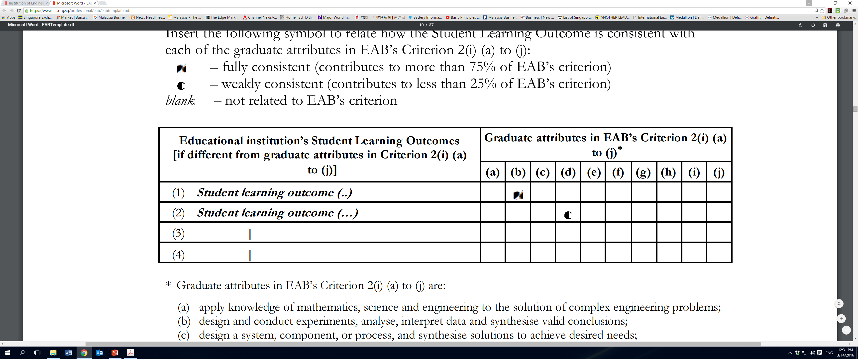

Slide 35
Student Learning Outcomes
Illustrations of how
  course outcomes
  modes of delivery of the courses
  assessment tools
  laboratory
  project course work
  are used to assess the impact of course delivery/course content, and are contributing towards the attainment of the SLOs
Attainment of SLOs assessed by direct and indirect methods

Slide 36
Student Learning Outcomes
Results of assessment of each SLO shall be indicated as they play a vital role in implementing the Continuous Improvement process of the programme
How the results of assessment of the SLOs are used to improve the programme in terms of
  curriculum
  course delivery
  assessment methods
  processes of revising/redefining the SLOs

Slide 38
Programme Curriculum
Programme curriculum that leads to the attainment of the PEOs and the SLOs must be designed
Flow diagram that shows the prerequisites for the courses shall also be provided
Each programme should cover general and specialized professional content of adequate breadth and depth
Appropriate components in the Sciences and Humanities.

Slide 39
Programme Curriculum
The relevance of curriculum components including core engineering courses to the SLOs
How the core engineering subjects in the curriculum lend the learning experience with the complex engineering problems
Programme must satisfy Programme Specific Criteria
Continuous Improvement process in curriculum refinement
Evidence of assessment, evaluation and review methods – attainment of COs

Slide 41
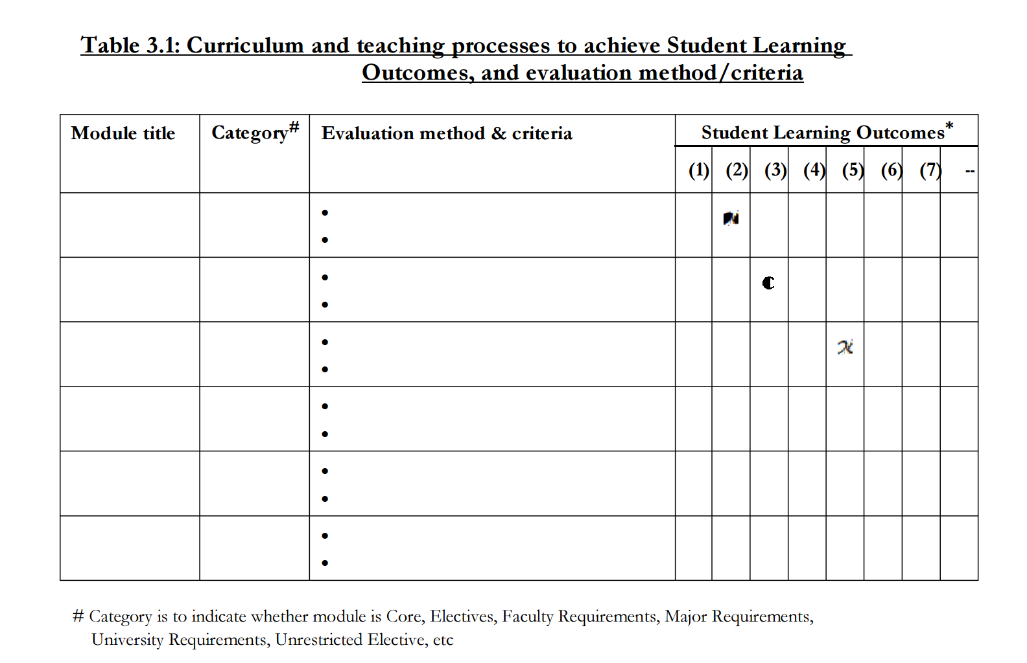

Slide 42
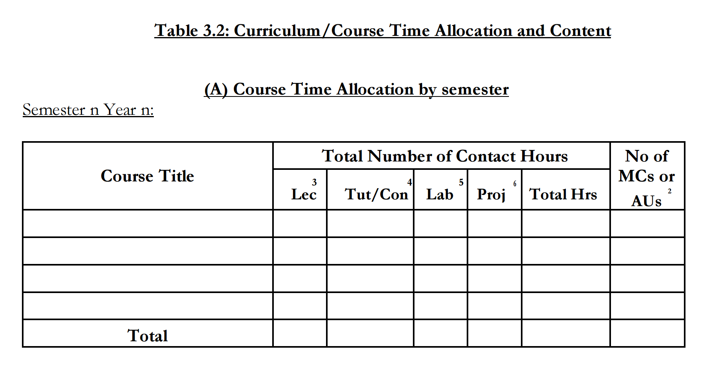

Slide 43
Complex problems
(A requirement of WA)
Involve wide-ranging or conflicting technical, engineering and other issues
Have no obvious solution and require abstract thinking, originality in analysis to formulate suitable models
Requires research-based knowledge much of which is at, or informed by, the forefront of the professional discipline and which allows a fundamentals-based, first principles analytical approach
Involve infrequently encountered issues
Are outside problems encompassed by standards and codes of practice for professional engineering
Involve diverse groups of stakeholders with widely varying needs
Have significant consequences in a range of contexts
Are high level problems including many component parts or sub-problems

Slide 44
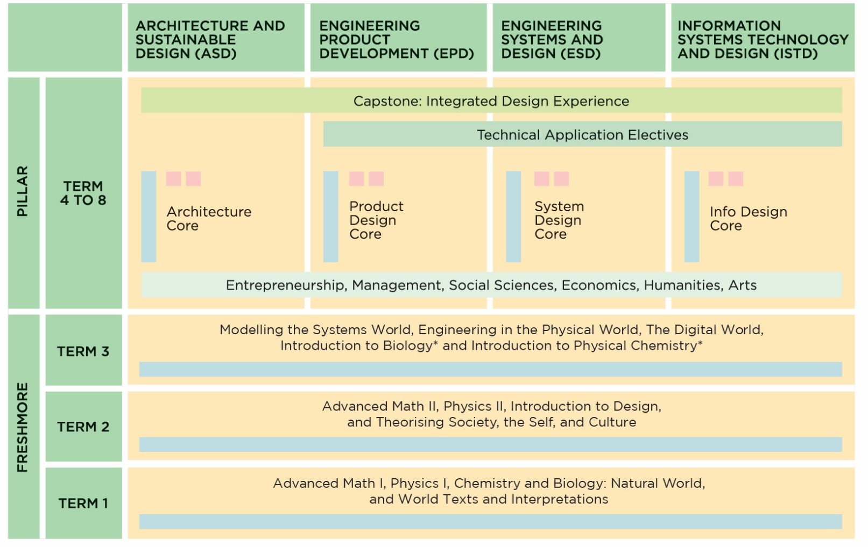
Unique Academic Structure at Singapore University of Technology and Design
http://www.sutd.edu.sg/Education/

Slide 45
Evaluation of SLOs
Attainment of each SLOs must be carefully evaluated in terms of depth and breadth stipulated – going through evidences provided
Application to Complex Engineering Problems

Slide 46
The achievement of
each SLO, both breadth
and depth, should be assessed
and evaluated.

Slide 47
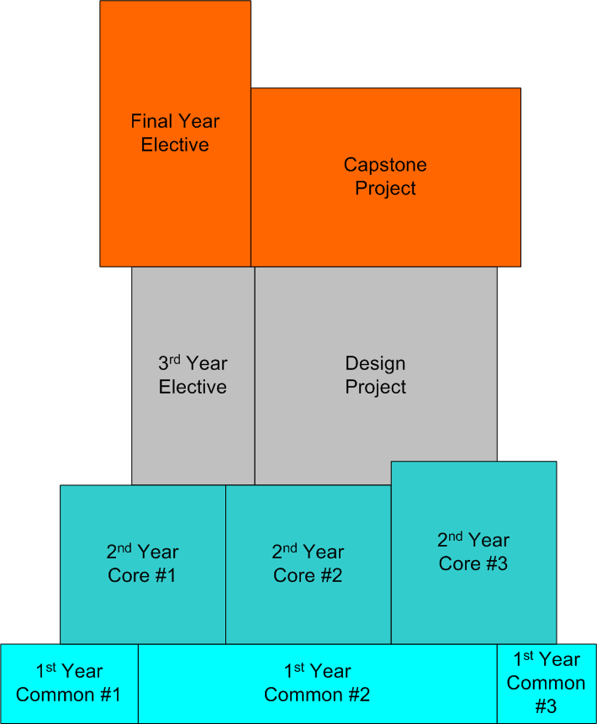
PLO #3
Depth
Breadth

Slide 48

SLO Folder
For accreditation evaluation, good to prepare a folder for each outcomes
Contains relevant subjects and assessment details which support achievement of the SLO
Includes other student learning activities and assessment details
Samples of student work

Slide 49
Evidence beyond mapping exercise
Program Accreditation Committee undertake the task of mapping subjects/courses to each outcomes
Faculty teaching a particular subject is not aware of the outcomes contribution from his subject, and has not conducted proper outcomes assessment
Just a mapping exercise – not acceptable

Slide 50
Evidences from Meetings/Interviews
Provost/President
Dean and Head of Department/Program
Group of faculty members
Group of alumni
Group of students
Group of other constituencies, e.g. members of industrial advisory board, employers

Slide 51
Evidences from Examination of Exhibits (1)
Sample of teaching materials
CV of faculty staff, publications
Sample of exam papers
Sample of exam scripts –excellent, good, marginal
Transcripts of immediate past graduates
Sample project and design reports
Sample of industry attachment reports & assessment

Slide 52
Evidences from Examination of Exhibits (2)
Samples of student feedback form
Reports of other internal or external reviews of the course, department and faculty
Results of quality assurance reviews
Statistics of graduate employment
Other documents requested by the evaluaton team

Slide 54
Course Learning Outcomes (COs)
A learning outcome is what a student can do as a result of a learning experience.
It describes a specific task that student is able to perform at a given level of competence under a certain situation.
The three broad types of learning outcomes are:
  Disciplinary knowledge and skills
  Generic skills
  Attitudes and values

Slide 55
Table 3.1: Curriculum and teaching processes to achieve Student Learning Outcomes,
and evaluation method/criteria
Module | Category# | Evaluation method & criteria | Student Learning Outcomes*
 |  |  | (1) | (2) | (3) | (4) | (5) | (6) | (7) | --

Slide 56
Course Learning outcomes
Course Learning Outcomes describe the complex performances a student should be capable of as a result of learning experiences within a course.
These are determined by the course instructor (s)
Mapping course learning outcomes to program outcomes and how overall learning experience meet the accreditation criteria

Slide 57
Learning outcomes
of a subject/course
may support several
SLOs.
Evidence of course
assessment to be
documented.

Slide 58
Contribution of each course
Each undergraduate course in the programme contributes to a list of SLOs
Usually, a course may contribute strongly to some SLOs and less strongly to other SLOs
While a course may contribute to several SLOs, usually only a subset of its strong outcomes need to be used for SLO assessment.

Slide 59
Evidences of Outcomes Assessment
Not merely mapping of courses to outcomes
Evidence of outcomes assessment at course level
Evidence that faculty has training in conducting outcomes assessment
Going beyond subject/course marks & grading being used as justification that overall outcomes are contributed by the subject(s)

Slide 60
Evidence of Faculty actively involved in outcomes assessment
Do faculty members know the requirements of outcome-based accreditation?
Are they trained in outcomes assessment?
Evidence of faculty conducting outcomes assessment at their courses
Reflection and continuous improvement at course level

Slide 61
Avoid Obsession with Assessment
Assessment involves:
  Cognitive domain (thinking, knowledge)
  Psychomotor domain (doing, skills)
  Affective domain (feeling & attitude)
Is the assessment efforts sustainable?

Slide 62
Bloom’s Taxonomy – Cognitive Domain
(modified by Anderson & Krathwohl)
Creation
Evaluation
Compare, decide …
Synthesis
Design …
Analysis
Analyse …
Application
Calculate …
Comprehension
Explain …
Knowledge (Remembering)
List …

Slide 63
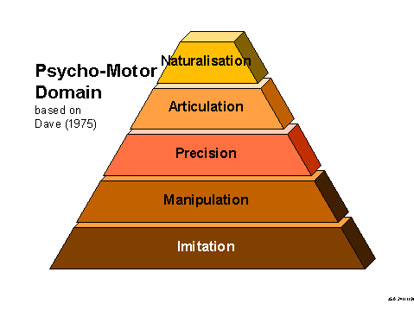
Psychomotor Domain
http://www.learningandteaching.info/learning/bloomtax.htm

Slide 64
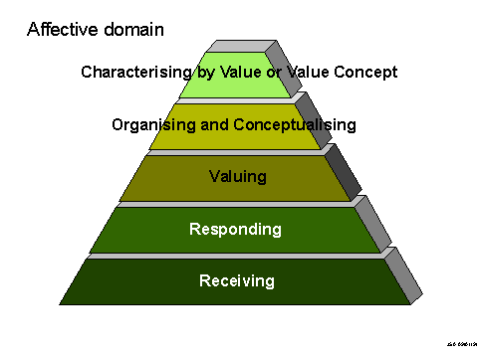
Affective Domain
http://www.learningandteaching.info/learning/bloomtax.htm

Slide 65
Wrong Justification of Outcomes Attainment
Wrong interpretation of the Bloom’s Taxonomy
Entry level courses are used to map achievement of outcomes at mastery level simply because some assessment exercises include activities of
  Write
  Evaluate
  Design, etc
Note that Complex Engineering Problems should be used for assessment at masterly level

Slide 66
Evidences that Curriculum adequate to support all the 12 SLOs
Curriculum adequately structured to achieve all the 12 SLOs?
Common curriculum deficiencies
  The engineer and society
  Environment and sustainability
  Ethics
  Finance and project management

Slide 67
Curriculum
Does the curriculum satisfy the program specific criteria of the particular engineering discipline?
Are performance indicators established to measure the outcomes of the courses with respect to the student learning outcomes of accreditation criteria)?
Major design experience?
Prerequisites
Course syllabi
Cores and electives

Slide 68
Adequate evidences to demonstrate compliance with criteria?
Sufficient evidences to demonstrate compliance with criteria?
Best practices
  Course folders
  Folders for each outcomes
  Samples of student portfolio

Slide 69
Check Samples of Student Works
Each course is required to save samples of student homework solutions, laboratory reports, project or design reports, and exam solutions, typically from poor to good quality.
At the end of each quarter, the lecturers of all undergraduate courses must compile a binder containing in addition to the solutions, the corresponding homework questions, exam questions, lab description, and project description.

Slide 70
Assessment
&
Demonstration of Outcomes Achievement
Breadth
Depth
Where gained
Learning Process
Assessment Methods
Reference: Designing Better Engineering Education Through Assessment
by JE Spurlin, SA Rajala & JP Lavelle
Stylus Publishing LLC, 2008

Slide 71
Assessment of SLO
Assessment is big subject and probably the major challenge of the teaching faculty
Are assessment methods adequate to provide evidence of achievement of SLO?
Each SLO may be measured or evaluated in terms of performance indicators
Is there a system in place to ensure that students will acquire the stated SLO before graduation? (bearing in mind the various core and optional subjects available, and overseas attachment)

Slide 72
Evidences Required
Demonstrate that students have achieved the specified learning outcomes at appropriate level by the time of graduation, and
Provide evidence that the program has contributed to students’ ability to achieve the SLOs

Slide 73
Assessment of SLO – Where?
Course work & curricular activities
  Classes chosen, major
Classroom experience
  Pedagogy, facilities, faculty & student interaction
Out-of-class experience
  Co-curricular, internships, support services

Slide 74
Capstone/Final Year Project
A well-designed capstone/final year project is a culminating demonstration of whole range of learning outcomes
Depth of specialized topic, e.g. design, analysis, investigation, ..
Breadth of other outcomes, e.g. communication, environment, project management, …

Slide 75
Assessment Methods
Written exams
Class tests
Project reports
Final Year/Capstone projects
Design assignments
Locally developed examinations, e.g. FEE for Professional Engineers
Oral exam
Internship/Industry Attachment report
Lab reports
Written surveys and questionnaires
Exit and other interviews
Focus groups
External examiner
End-of-course instructor survey
End-of-course student survey
Portfolios
…

Slide 76
Concluding Remarks
Onsite accreditation visits should focus on evidence-based assessment of attainment of outcomes
Adequate breadth and depth of POs
Evidences of outcomes assessment – at course level
Evidence of Continuous Improvement process
Outcomes folder, course folder, portfolio of student work
Evidences from interactions with stakeholders – faculty, students, alumni, …

Slide 77

Q&A
Thank you

