Slide 1

One Day Workshop on
Outcome Based Education
20 April 2014
UET, Lahore, Pakistan

Slide 2
Programme
Time | Topic / Activity
09.00 – 09.30 | Introduction
09.30 – 10.30 | Linking Programme Objectives and Outcomes & Course Outcomes
10.30 – 10.45 | Refreshment
10.45 – 11.45 | Exercise 1
11.45 – 12.45 | Developing Course Outcomes that address the taxonomy
12.45 – 14.00 | Lunch
14.00 – 15.00 | Exercise 2
15.00 – 16.00 | Ensuring attainment of outcomes through assessments
16.00 – 17.00 | Exercise 3 & Closing
17.00 | Refreshment

Slide 3
Reminder
A unified template is not the way forward
This is an attempt to allow contemplation and creativity
Diversity in approach is expected but unified in outcome

Slide 4
Expectations of Accreditation
Education content and level are maintained
Programme Continual Quality Improvement (CQI)
Outcome-based Education (OBE) Programme
Systematic (QMS)

Slide 5
Introduction

Slide 6
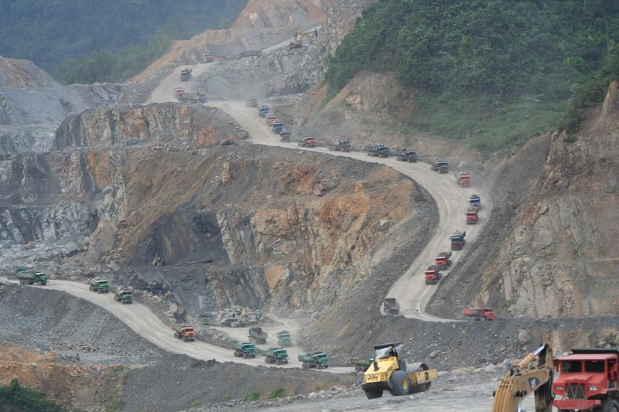
ACCULTURALISATION
QUALITY EDUCATION
Knowledge
Behaviour
Attitude
  Establish, Maintain & Improve System
  Resources
  Management Commitment

Slide 7
Program
Objectives & Outcomes
Students
Staff
QMS
Facilities
Curriculum
Quality
Improvement

Slide 8
Professional Engineers
Engineers
Technologist
Others
ENGINEERING GRADUATES OUTCOMES

Slide 9
Professional Engineers
Engineers
Technologists
Others
PAE
+
3 years
Work Experience
(Normally
5 year
+
Registered with the Board
Registered with the Board
ENGINEERING GRADUATES OUTCOMES

Slide 10
ENGINEERING PROGRAMME
Education
(Knowledge & Understanding)
Training
(Skill)
Cognitive
(Knowledge – K)
Psychomotor
(Skill – S)
Affective
(Attitude – A)

Slide 11
Depth of Knowledge Required
Complex Problems | Broadly Defined Problems | Well defined Problems
Requires in-depth knowledge that allows a fundamentals-based first principles analytical approach
Requires knowledge of principles and applied procedures or methodologies
Can be solved using limited theoretical knowledge, but normally requires extensive practical knowledge

Slide 12
Attributes | Complex Problems
Preamble | Engineering problems which cannot be resolved without in-depth engineering knowledge and having some or all of the following characteristics:
Range of conflicting requirements | Involve wide-ranging or conflicting technical, engineering and other issues
Depth of analysis required | Have no obvious solution and require abstract thinking, originality in analysis to formulate suitable models
Depth of knowledge required | Requires in-depth knowledge that allows a fundamentals-based first principles analytical approach
Familiarity of issues | Involve infrequently encountered issues
Level of problem | Are outside problems encompassed by standards and codes of practice for professional engineering
Extent of stakeholder involvement and level of conflicting requirements | Involve diverse groups of stakeholders with widely varying needs
Consequences | Have significant consequences in a range of contexts
Interdependence | Are high level problems possibly including many component parts or sub-problems
Engineering Programme

Slide 13
Attributes | Broadly-defined Problems
Preamble | Engineering problems having some or all of the following characteristics:
Range of conflicting requirements | Involve a variety of factors which may impose conflicting constraints
Depth of analysis required | Can be solved by application of well-proven analysis techniques
Depth of knowledge required | Requires knowledge of principles and applied procedures or methodologies
Familiarity of issues | Belong to families of familiar problems which are solved in well-accepted ways;
Level of problem | May be partially outside those encompassed by standards or codes of practice
Extent of stakeholder involvement and level of conflicting requirements | Involve several groups of stakeholders with differing and occasionally conflicting needs
Consequences | Have consequences which are important locally, but may extend more widely
Interdependence | Are parts of, or systems within complex engineering problems
Technology Programme

Slide 14
(i) Knowledge of Engineering Sciences
Differentiation Characteristic | WA | SA | DA
Breadth and depth of education and type of knowledge, both Theoretical and Practical | Apply knowledge of mathematics, science, engineering fundamentals and an engineering specialization to the solution of complex engineering problems (conceptualization of engineering models) | Apply knowledge of mathematics, science, engineering fundamentals and an engineering specialization to defined and applied engineering procedures, processes, systems or methodologies. | Apply knowledge of mathematics, science, engineering fundamentals and an engineering specialization to wide practical procedures and practices.

Slide 15
(ii) Problem Analysis
Differentiation Characteristic | WA | SA | DA
Complexity of analysis | Identify, formulate, research literature and analyse (solve) complex engineering problems reaching substantiated conclusions using first principles of mathematics, natural sciences and engineering sciences. | Identify, formulate, research literature and solve broadly-defined engineering problems reaching substantiated conclusions using analytical tools appropriate to their discipline or area of specialisation. | Identify and solve well-defined engineering problems reaching substantiated conclusions using codified methods of analysis specific to their field of activity.

Slide 16
(iii) Design/ development of solutions
Differentiation Characteristic | WA | SA | DA
Breadth and uniqueness of engineering problems i.e. the extent to which problems are original and to which solutions have previously been identified or codified | Design solutions for complex engineering problems and design systems, components or processes that meet specified needs with appropriate consideration for public health and safety, cultural, societal, and environmental considerations. | Design solutions for broadly- defined engineering technology problems and contribute to the design of systems, components or processes to meet specified needs with appropriate consideration for public health and safety, cultural, societal, and environmental considerations. | Design solutions for well-defined technical problems and assist with the design of systems, components or processes to meet specified needs with appropriate consideration for public health and safety, cultural, societal, and environmental considerations.

Slide 17
(iv) Investigation
Differentiation Characteristic | WA | SA | DA
Breadth and depth of investigation and experimentation | Conduct investigations (of) into complex problems using research based knowledge and research methods including design of experiments, analysis and interpretation of data, and synthesis of information to provide valid conclusions. | Conduct investigations of broadly-defined problems; locate, search and select relevant data from codes, data bases and literature, design and conduct experiments to provide valid conclusions. | Conduct investigations of well-defined problems; locate and search relevant codes and catalogues, conduct standard tests and measurements.

Slide 18
(v) Modern Tool Usage
Differentiating Characteristic: Level of Understanding of the Appropriateness of the Tool
Engineer – Washington Accord | Engineering Technologist – Sydney Accord | Engineering Technician – Dublin Accord
Create, select, and apply appropriate techniques, resources, and modern engineering and IT tools, including prediction and modelling, to complex engineering activities, with an understanding of the limitations | Select and apply appropriate techniques, resources, and modern engineering tools, including prediction and modelling, to broadly defined engineering activities, with an understanding of the limitations | Apply appropriate techniques, resources, and modern engineering tools to well-defined engineering activities, with an awareness of the limitations

Slide 19
(vi) The Engineer and Society
Differentiation Characteristic | WA | SA | DA
Level of knowledge and responsibility | Apply reasoning informed by contextual knowledge to assess (Demonstrate understanding of the) societal, health, safety, legal and cultural issues and the consequent responsibilities relevant to professional engineering practice. | Demonstrate understanding of the societal, health, safety, legal and cultural issues and the consequent responsibilities relevant to engineering technology practice. | Demonstrate knowledge of the societal, health, safety, legal and cultural issues and the consequent responsibilities relevant to engineering technician practice.

Slide 20
(vii) Environment and Sustainability
Differentiation Characteristic | WA | SA | DA
No differentiation in this characteristic | Understand the impact of professional engineering solutions in a societal and environmental contexts and demonstrate knowledge of and need for sustainable development. | Understand the impact of engineering solutions in a societal context and demonstrate knowledge of and need for sustainable development. | Understand the impact of engineering solutions in a societal context and demonstrate knowledge of and need for sustainable development.

Slide 21
(viii) Ethics
Differentiating Characteristic: None
Engineer – Washington Accord | Engineering Technologist – Sydney Accord | Engineering Technician – Dublin Accord
Apply ethical principles (Understand) and commit to professional ethics, responsibilities, and norms of engineering practice | Understand and commit to professional ethics, responsibilities, and norms of engineering practice | Understand and commit to professional ethics, responsibilities, and norms of engineering practice

Slide 22
(ix) Communication
Differentiation Characteristic | WA | SA | DA
Level of communication according to type of activities performed | Communicate effectively on complex engineering activities with the engineering community and with society at large, such as being able to comprehend and write effective reports and design documentation, make effective presentations, and give and receive clear instructions. | Communicate effectively on broadly-defined engineering activities with the engineering community and with society at large, by being able to comprehend and write effective reports and design documentation, make effective presentations, and give and receive clear instructions | Communicate effectively on well-defined engineering activities with the engineering community and with society at large, by being able to comprehend the work of others, document their own work, and give and receive clear instructions

Slide 23
(x) Individual and Teamwork
Differentiation Characteristic | WA | SA | DA
Role in and diversity of team | Function effectively as an individual, and as a member or leader in diverse teams and in multi-disciplinary settings. | Function effectively as an individual, and as a member or leader in diverse technical teams. | Function effectively as an individual, and as a member in diverse technical teams.

Slide 24
(xi) Life long learning
Differentiation Characteristic | WA | SA | DA
No differentiation in this characteristic | Recognize the need for, and have the preparation and ability to engage in independent and life-long learning.in the broadest context of technological change | Recognize the need for, and have the ability to engage in independent and life-long learning. | Recognize the need for, and have the ability to engage in independent and life-long learning.

Slide 25
(xii) Project Management and Finance
Differentiation Characteristic | WA | SA | DA
Level of management required for differing types of activity | Demonstrate knowledge and understanding of engineering and management principles and apply these to one’s own work, as a member and leader in a team, to manage projects and in multidisciplinary environments (business practices, such as risk and change management, and understand their limitations.) | Demonstrate an awareness and understanding of management and business practices, such as risk and change management, and understand their limitations. | Demonstrate an awareness of management and business practices, such as risk and change management.

Slide 26
MEASURE & EVALUATE
Direct & Indirect
Student, Alumni Perception
Employer, Industry Perception
University Assessment & Evaluation

Slide 27
Linking Programme Objectives and Outcomes & Course Outcomes

Slide 28
1. Assign yourself an anonymous name
2. Rate between 1 to 5 with 1 “not at all” and 5 “yes a lot”
 |  | Before Workshop | After Workshop
A | My knowledge of outcome-based education is at level
(i) I would like to know more about …..
(ii) Comments:

Slide 29
Introduction to OBE

Slide 30
OBE Meets IHL (Before ... 2005)
Who is the Smart Alex that brought this OBE idea ?
Why do we need OBE?
This is American (WASHINGTON) hegemony!
Canada, Hong Kong, Singapore ... are not OBE

Slide 31
OBE Training 2005 - 2008
2008 WA Reviewer UKM, UPM
2008 WA Mentor KLIUC, UNITEN, UiTM
2007 WA Mentor UniMAP, UTP
2005 WA Mentor UTM UTeM
2004 WA Mentor UKM, MMU
2002 WA Sponsor UiTM, UIA 2009: OBE Effective
2008: OBE Widespread
2007: CQI Visible
2006: OBE Implementation
2005: OBE Plan
2007: OBE Manual
2006: OBE Manual
2003: OBE Manual
1999: OBE Manual
99
00
01
02
03
04
05
06
07
08
09
10
(Year)

Slide 32
Buy-in
Universities
  Have to
  Paradigm shift – give us time
EAC
  Impatient
  Process
EAC panels
  Paradigm shift

Slide 33
OBE Meets IHL (Now ... 2010)
May God bless the Smart Alex that brought the idea!
OBE makes us accountable
What is the best way of doing OBE?
Let us assess and evaluate the learning of students the right way

Slide 34
Outcome Based Education
OBE is a process that involves assessment and evaluation practices in education to reflect the attainment of expected learning and showing mastery in the programme area

Slide 35
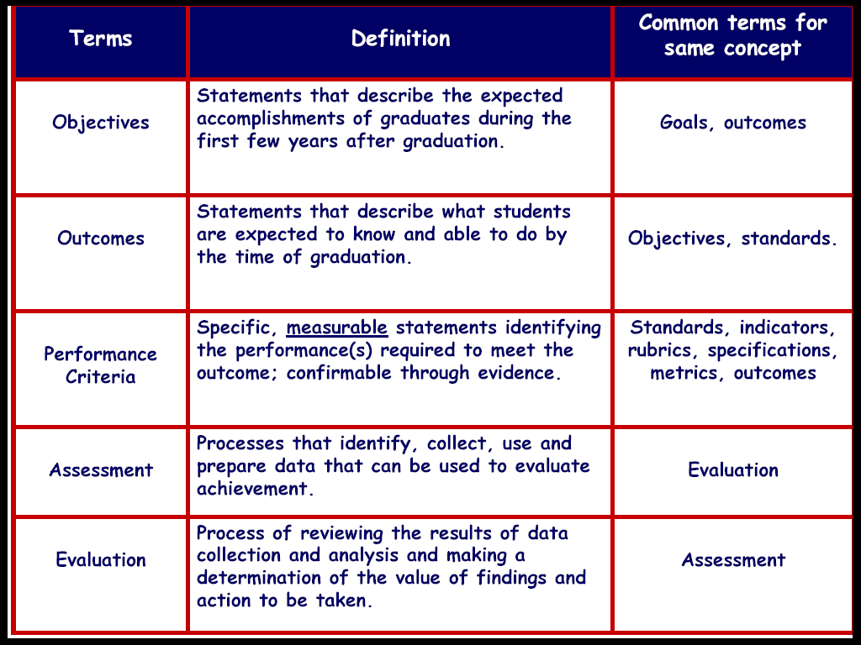

Slide 36
OBE leads to:
Improved Learning
Increase in Institutional effectiveness
Enhanced Accountability

Slide 37
Benefits of OBE
  More directed & coherent curriculum
  Graduates will be more “relevant” to industry & other stakeholders (more well rounded graduates)
  Continual Quality Improvement (CQI) is an inevitable consequence

Slide 38
OBE in a nut shell
What do you want the students to have or able to do?
Knowledge, Skill, Affective
How can you best help students achieve it?
Student Centred Delivery
How will you know what they have achieved it?
Assessment
How do you close the loop
PDCA

Slide 39
Strategy of OBE
Top down curricula design
Appropriate Teaching & Learning Methods
Appropriate Assessment & Evaluation Methods

Slide 40
Developing OBE Curricula
Vision & Mission
Stakeholders Input
Malaysian Engineering Education Model
  Global & strategic
  Industrial
  Humanistic
  Practical
  Scientific
  Professional
SWOT Analysis

Slide 41
Characteristics of OBE curricula
It has programme objectives, programme outcomes, course learning outcomes and performance indicators.
It is objective and outcome driven, where every stated objective and outcomes can be assessed and evaluated.
It is centered around the needs of the students and the stakeholders.

Slide 42
Characteristics of OBE curricula cont….
Every learning outcome is intentional and therefore the outcomes must be assessed using suitable performance indicators.
Programme objectives address the graduates attainment within 3-5 years after their graduation.
Programme outcomes, which consist of abilities to be attained by students before they graduate, are formulated based on the programme objectives.

Slide 43
Characteristics of OBE curricula cont….
Programme outcomes address Knowledge, Skills and Attitudes to be attained by students.
Course outcomes must satisfy the stated programme outcomes. There is no need for ANY (individual) course to address all programme outcomes.
Teaching/ Learning method may have to be integrated to include different delivery methods to complement the traditional Lecture method.

Slide 44

Issues on Implementation of OBE
Effective Programme Educational Objectives (PEO)
Effective Programme Outcomes (PO).
Practical Assessment Tools.
Effective Assessment Planning.
Robust Evaluation Planning.
CQI procedures in place
Management Driven! Management Commitment!

Slide 45
Different Levels of Outcomes
Programme Educational Objectives
Few years after
Graduation – 4 to 5 years
Programme Outcomes
Upon graduation
Course/subject Outcomes
Upon subject completion
Weekly/Topic Outcomes
Upon weekly/topic
completion

Slide 46

Institutional
Mission Statement
Stakeholders Interest
Programme Objectives
Programme Outcomes
(Knowledge, skills, attitudes of graduates)
Outcome-Related Course Learning Objectives
(Ability to: explain, calculate, derive, design)
Assessment of Attainment Level
Continual Improvement

Slide 47
Model B: Greater emphasis on skills and attitude at the early years but lesser toward the middle years and back to greater emphasis near graduation
Semester 8
Semester 1
Skills &
Attitude
Knowledge
Development Concept of Outcome-based Education
1. programmeme Objectives
2. programmeme Outcomes
EAC requirements
EAC requirements
Employers’ requirements
ABET requirements
NGOs requirements
Faculties’ expectations
School’s vision and mission
MEEM requirements
Semester 8
Semester 1
Skills &
Attitude
Knowledge
3. Develop Curriculum Structure
4. Develop Course learning outcomes
5. Develop Course outcomes
Model A: Equal emphasis on the knowledge, skills and attitude from the early years until graduation
Assessment and Evaluation for Continual Improvement

Slide 48
Educational Process - Stakeholders
Internal Stakeholders
Teachers
Students
University
Pull
factor
Programme EO / O Development/ Review
Specification
Course O / Content
Development / Review
1, 2, 3 ……
External Stakeholders
Potential Employers / Industry
Alumni
Regulatory Body
Course Implementation
1, 2, 3 ……
Internal Stakeholders
Teachers
Formative / Summative
Course Assessment
1, 2, 3 ……
Teacher – Knowledge, Skills, Affective
Students – Teaching
Teacher – Descriptive Self Assessment
on Cohort’s Achievement
Internal Stakeholders
Teachers
Technicians
Students
Internal Stakeholders
Teachers
Students
Programme Evaluation
Summative - direct
Exit Survey - indirect
Industry Survey - indirect
Alumni Survey - indirect
External – direct
Accreditation - direct
Summative
External Stakeholders
Potential Employers / Industry
Alumni
Regulatory Body
External Assessor

Slide 49
A
CQI
Programme
Outcomes
Course
Outcomes
Teaching Plan
CQI
1
Implementation
CQI
Contents
2
Levels
Contact Time
Cohort’s
Evaluation
Learning Time
3
Assessments

Slide 50
Intervention
for the following year
5
Cohort’s
Evaluation
3
Summative
at year
4
Summative
4 years
6
A
CQI
Programme
Outcomes
Course
Outcomes
Other
Stakeholders
B

Slide 51
Programme Objectives

Slide 52

Programme Objectives
What is expected (3-5 years) upon graduation (What the programme is preparing graduates in their career and professional accomplishments)

Slide 53
CHARACTERISTICS OF GOOD PROGRAMME OBJECTIVE (PEO) STATEMENTS
Each addresses one or more needs of one or more stakeholders
Consistent with the mission & vision of the institution
Number of statements should be limited and manageable
Should not be simply restatement of outcomes
Forward looking and challenging

Slide 54
CHARACTERISTICS OF GOOD POGRAMME OBJECTIVE (PEO) STATEMENTS
Should be stated such that a graduate can demonstrate in their career or professional life after graduation (long term in nature)
Distinctive/unique features/having own niche
Specific, Measurable, Achievable, Result oriented, and having a Time frame (SMART)
Has clear link to the programme outcomes & curriculum design

Slide 55
eg. Programme Educational Objectives
To provide graduates with sufficient knowledge in engineering and possess the necessary skills for work in the industry.
To produce graduates who are sensitive and responsible towards the society, culture and environment.
To prepare graduates for work in advanced design and innovation at international level.

Slide 56
Programme Outcomes

Slide 57

Programme Outcomes
What the graduates are expected to know and able to perform or attain by the time of graduation (skills, knowledge and behaviour/attitude)
There must be a clear linkage between Objectives and Outcomes
Need to distribute the outcomes throughout the programme, and not one/two courses only addressing a particular outcome

Slide 58
Employers Rating of Skills/Qualities – 2002
Communication (verbal & written) 4.69
Honesty/Integrity 4.59
Teamwork skills 4.54
Interpersonal skills 4.50
Strong work ethics 4.46
Motivation & initiative 4.42
Flexibility/adaptability 4.41
Analytical skills 4.36
Computer skills 4.21
Organisational skills 4.05
Detail oriented 4.00
Leadership skills 3.97
Self confidence 3.95
Friendly/outgoing personality 3.85
Well mannered / polite 3.82
Tactfulness 3.75
GPA (3.0 or better) 3.68
Creativity 3.59
Sense of humour 3.25
Entrepreneurial skills/risk taker 3.23

Slide 59
PEC 2014 Manual
Programme Outcomes
Expected to know and able to perform or attain by the time of graduation. (knowledge, skills, and behaviour/attitude - KSA)
Outcomes (i) to (xii)

Slide 60



PROGRAMME OUTCOME
(i) Engineering Knowledge
Apply knowledge of mathematics, science, engineering fundamentals and an engineering specialisation to the solution of complex engineering problems;

Slide 61
PROGRAMME OUTCOME
(ii) Problem Analysis
Identify, formulate, research literature and analyse complex engineering problems reaching substantiated conclusions using first principles of mathematics, natural sciences and engineering sciences

Slide 62
PROGRAMME OUTCOME
(iii) Design/Development of Solutions
Design solutions for complex engineering problems and design systems, components or processes that meet specified needs with appropriate consideration for public health and safety, cultural, societal, and environmental considerations

Slide 63
PROGRAMME OUTCOME
(iv) Investigation
Conduct investigation into complex problems using research based knowledge and research methods including design of experiments, analysis and interpretation of data, and synthesis of information to provide valid conclusions

Slide 64
PROGRAMME OUTCOME
(v) Modern Tool Usage
Create, select and apply appropriate techniques, resources, and modern engineering and IT tools, including prediction and modelling, to complex engineering activities, with an understanding of the limitations

Slide 65
PROGRAMME OUTCOME
(vi) The Engineer and Society
Apply reasoning informed by contextual knowledge to assess societal, health, safety, legal and cultural issues and the consequent responsibilities relevant to professional engineering practice

Slide 66
PROGRAMME OUTCOME
(vii) Environment and Sustainability
Understand the impact of professional engineering solutions in societal and environmental contexts and demonstrate knowledge of and need for sustainable development

Slide 67
PROGRAMME OUTCOME
(viii) Ethics
Apply ethical principles and commit to professional ethics and responsibilities and norms of engineering practice

Slide 68
PROGRAMME OUTCOME
(ix) Communication
Communicate effectively on complex engineering activities with the engineering community and with society at large, such as being able to comprehend and write effective reports and design documentation, make effective presentations, and give and receive clear instructions

Slide 69
PROGRAMME OUTCOME
(x) Individual and Team Work
Function effectively as an individual, and as a member or leader in diverse teams and in multi-disciplinary settings

Slide 70
PROGRAMME OUTCOME
(xi) Life-long Learning
Recognise the need for, and have the preparation and ability to engage in independent and life-long learning in the broadest context of technological change

Slide 71
PROGRAMME OUTCOME
(xii) Project Management & Finance
Demonstrate knowledge and understanding of engineering and management principles and apply these to one’s own work, as a member and leader in a team, to manage projects and in multidisciplinary environments

Slide 72
Exercise 1
Develop several programme objectives based on the kind of graduates your programme intent to produce.
Link the POs to PEC 2014 programme outcomes

Slide 73
Curricula

Slide 74
Curricula Models
Distribution of Knowledge, Skills & Attitude
elements throughout the 4 years
Yr. 4
S&A
30%
S&A
30%
Yr. 3
K 70%
K 70%
K 70%
K 70%
Yr. 2
S&A
30%
Yr. 1
S&A
30%
A
B
C
D

Slide 75
Curriculum
50% devoted to project work
25% to courses related to the project
25% to courses related to the curriculum
Theme – increase knowledge, broad range of subjects, professional input

Slide 76
Lecture & Project
Introduction
Evaluation
Course
Project work

Slide 77
Problem Organised Project Work or POPBL (Project Oriented Problem Based Learning)
Lectures
Group Studies
Literature
Problem Analysis
Problem Solving
Report
Tutorials
Field Work
Experiment

Slide 78
Requirements
High degree of supervision
Office space
Lectures to be constantly changing or renewed
Flexibility in the distribution of resources

Slide 79
Graduates
AALBORG UNIV
Strong in problem solving
Communication
Cooperation
General technical knowledge
TECHNICAL UNIV
Specialist knowledge
Technical methodology

Slide 80
Chinese Proverb
Tell me and I will forget
Show me and I will remember
Involve me and I will understand
Step back and I will act

Slide 81
Instructors/Supervisors
Pedagogical skills
Scientific skills
Time management
Project based on staff research

Slide 82

Requirements for the students
Active role – must come prepared for each class; contribute by teaching others, actively participating, taking risks, learning from instructor/classmates
Ethics – respect, trust and openess
Committed to learning – continual improvement

Slide 83
Linking topics to Programme Educational Objectives
Topics lead to learning objectives
Group/individual learning objectives lead to course outcome
Course outcomes must relate to programme outcomes
Programme outcomes address the programme objectives (What kind of “animal” are we producing?)

Slide 84
Course to Programme Outcomes Mapping

Slide 85

Ensuring attainment of outcomes through assessments

Slide 86
1. Assign yourself an anonymous name
2. Rate between 1 to 5 with 1 “not at all” and 5 “yes a lot”
 |  | Before Workshop | After Workshop
C | My knowledge of assessment and evaluation is at level
(i) I would like to know more about …..
(ii) Comments:

Slide 87
Topic Outcomes
Participants can apply the principles of assessment and evaluation for programme objectives, programme outcomes and course outcomes.

Slide 88
Introduction

Slide 89
ASSESSMENT:
Processes that identify, collect, use and prepare data for evaluation of achievement of programme outcomes or educational objectives.
EVALUATION:
Processes for interpretation of data and evidence from assessment practices that determine the program outcomes are achieved or result in actions to improve programme.

Slide 90
Assessment
  drives learning (necessary evil!)
  is formative or/and summative; to demonstrate student’s competence in demonstrating a specific outcome
  is the process that identify, collect, use and prepare data that can be used to evaluate attainment.

Slide 91

Assessment
Do not assess those that have not been taught

Slide 92
What Assessment?
Assessing Student/Cohort (Course Outcome)
Assessing Student/Cohort & Faculty (Programme Outcome)

Slide 93
Course vs Programme Outcomes Assessment
Degree of complexity
Time span
Accountability
Level of Faculty buy-in
Precision of measurement

Slide 94
Assessment Process
  Anecdotal vs. measured results
  Reliance on course grades only
  Over-reliance on indirect assessment (survey)

Slide 95
COURSE COVERAGE
Breadth of coverage is subject to the required outcomes,
(Knowledge (K) = 70-80 %, Skills (S) = 10-20%, Attitude (A) = 10-20%)
K
(70-80%)
S
(10-20%)
A
(10-20%)
3
3
3
3
3
3
3
3
3
2
2
2
2
2
2
1
1
1
1
1
1
1
Depth of coverage is subject to the required level of outcomes,
1(low), 2 (medium) or 3 (high)
COURSE ASSESSMENT

Slide 96
Course Coverage & Assessment
When assessing, an instructor must consciously assess and evaluate the applicable elements (Knowledge, Skills, Attitude). An activity may be used to examine all the three elements
Model A
Model B
Competencies
Competencies
Knowledge
Knowledge
Skills
Skills
Attitude
Attitude

Slide 97
Assessment tools
Exit surveys, Exit interviews (P)
Alumni surveys and interviews (P)
Employer surveys and interviews (P)
Job offers, starting salaries (relative to national benchmark) (P)
Admission to graduate schools (P)
Performance in group and internship assignments and in PBL situation (P,C)
Assignments, report and tests in capstone design course (P,C)
Standardized tests (P,C)
P: Program C: Course

Slide 98
Assessment tools (cont)
Student surveys, individual and focus group interviews (P,C)
Peer-evaluations, self evaluations (P,C)
Student portfolios (P,C)
Behavioral observation (P,C)
Written tests linked to learning objectives (C)
Written project reports (C)
Oral presentation, live or videotape (C)
Research proposals, student-formulated problems (C)
Classrooms assessment Techniques (C)

Slide 99

Expectations from Evaluators on Assessment
Course Assessment links to Course Outcomes / Programme Outcomes
Formative Assessment
Summative Assessment
Looking for content breadth & depth from direct assessment
Looking for students ability to attain the highest level (depth)

Slide 100

Lessons learnt from accreditation activities related to assessment
Does not know the teaching plan
Done without referring to the plan
Does not know how to translate plan into assessment
Assessing at low-medium level (not challenging)
No feedback to students except at end of semester
Does not know how to relate assessment to expected outcomes
Repetition
Bulk marking
Traditional assessments

Slide 101
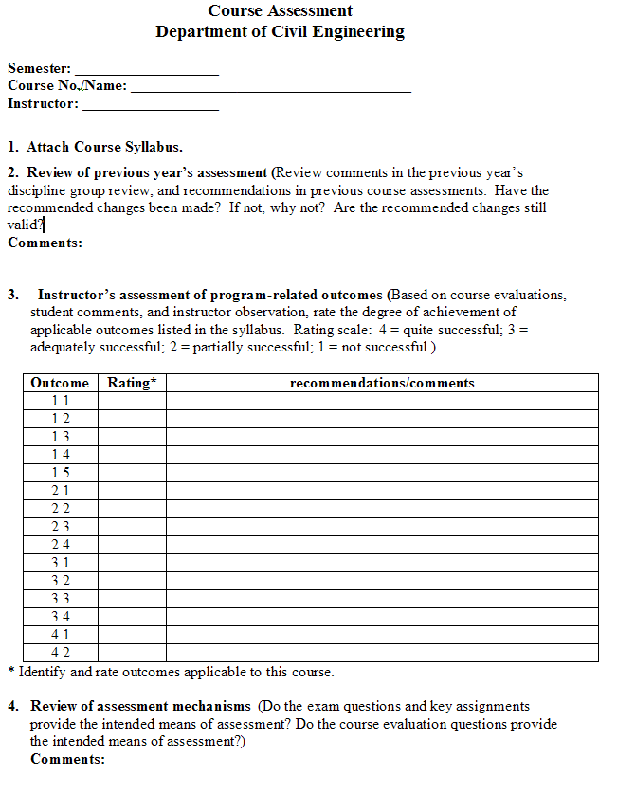
Course Summary Sheet

Slide 102
Assessing & Evaluating Course Outcomes
Let us look at some examples in assessment:
  Nutrition
  Natural Science

Slide 103
Course Outcomes (CO) -NUTRITION
CO: Children know the importance of washing their hands before eating as well as how to properly wash their hands
Use observation in assessment
At specified times during the 2 weeks following the session on hand washing, teachers recorded which children spontaneously washed their hands when it was time for a snack

Slide 104
Course outcomes (CO) - Natural Science
CO: Able to draw life cycle of a salmon
Ask to make drawings of the salmon's life once before the session, on the salmon's lifecycle and again at the end of the session
Changes in the details of the two drawings provide a demonstration of what had been learned

Slide 105

Observation

Slide 106
What skills do observers need?
Ability to take in what is seen, heard, and felt in an event, and to report those impressions and details clearly in writing.
Someone with good attention and writing skills is more likely to assemble a useful observation report than someone who struggles with these tasks.

Slide 107
Write notes / capture
Students working in a small group might talk excitedly while working out the solution to a problem
Recording their comments can provide valuable testimonial to the benefits of cooperative learning
Audiotapes, videotapes, or photographs may prove useful in capturing the essence of observed events

Slide 108
Observing
Be attentive and open to discovering behaviours, both verbal and nonverbal, that suggest the presence or lack of student motivation
Observations alone are not sufficient evidence for convincing others that a programme has caused lasting change (eg. observations of students working with each other during a 20-minute activity do not necessarily mean that students are more inclined to work cooperatively in general)
It is always important to look for several sources of evidence that support whatever changes you think have occurred in students

Slide 109
Indicators of student interest
How many students are participating in the discussion?
    What are they saying?
How do students look? Are they distracted or bored, or are they listening with interest?
How much personal experience do the students bring into their responses?
How excited do they seem about the subject?
    What do they say?

Slide 110
Know the student
You will need to know the students in order to be able to observe and record students participation

Slide 111
Rubrics

Slide 112
Rubric
It is a working guide for students and teachers, usually handed out before the assignment begins in order to get students to think about the criteria on which their work will be judged.
Authentic assessment tool which is designed to simulate real life activity where students are engaged in solving real-life problems.

Slide 113
Rubrics - What are they good for?
It is a set of categories developed from the performance criteria that define and describe progression toward meeting important components of work being completed, critiqued, or assessed.
Each category contains a gradation of levels of completion or competence with a score assigned to each level and a description of what performance criteria need to be met to attain the score at each level.

Slide 114
3 common features of rubrics
focus on measuring a stated objective (performance, behaviour, or quality).
use a range to rate performance.
contain specific performance characteristics arranged in levels indicating the degree to which a standard has been met (Pickett and Dodge).

Slide 115
Rubric
Adopted from G.Rogers
 | 4 - Exceeds Criteria | 3 - Meets Criteria | 2 - Progressing to Criteria | 1 - Below Expectations
Content | Provides ample supporting detail to support solution/ argument | Provides adequate supporting detail to support solution/ argument. | Some details but may include extraneous or loosely related material. | Inconsistent or few details that may interfere with the meaning of the text.
Organization | Organizational pattern is logical & conveys completeness & wholeness. | Organizational pattern is logical & conveys completeness & wholeness with few lapses. | Little completeness & wholeness, though organization attempted. | Little evidence of organization or any sense of wholeness & completeness.
Style | Uses effective language; makes engaging, appropriate word choices for audience & purpose. | Uses effective language & appropriate word choices for intended audience & purpose. | Limited & predictable vocabulary, perhaps not appropriate for intended audience & purpose. | Limited or inappropriate vocabulary for the intended audience & purpose.
 | Consistently follows the rules of standard English. | Generally follows the rules for standard English. | Generally does not follow the rules of standard English. | Does not follow the rules of standard English.

Slide 116

Types of Rubrics
An analytic rubric provides specific information about student performance on any given performance criterion.
A holistic rubric is broad in nature and provides information about the overall, general status of student performance (instead of creating separate categories for each criterion, the criteria are grouped under each level of the rubric).
A generic rubric can be used across a variety of activities where students get an opportunity to demonstrate their performance on an outcome (e.g., communication skills, where it could be used in a writing course or a design course).
A task-specific rubric is developed with a specific task in mind (focused and would not be appropriate to use outside of the task for which it was designed).

Slide 117
Rubric Scoring
The use of rubrics when scoring student work provides the programme with valuable information about how students are progressing and also points to specific areas where students need to improve.
  For example, when a staff member is grading a student’s paper, he/she can also score the paper for the student’s writing skills using the rubric provided.
  The scores obtained by each student can be aggregated and used for programme assessment.

Slide 118
Levels?
How many points (levels) should a rubric have?
It is important to consider both the nature of the performance (complexity) and the purpose of the scoring.
If the rubric aims to describe student performance at a single point in time, then three to five points are recommended.
If student performance is to be tracked over time and the focus is on developmental growth, then more points are needed.
Remember, the more points on the scale, the more difficult it is to get multiple raters to agree on a specific rating.

Slide 119
Effective Rubrics
For programme assessment, the most effective rubrics (generally speaking) are analytic, generic, and the use of a three- to five-point scale.
Good websites designed to help with the development of rubrics. http://edtech.kennesaw.edu/intech/rubrics.htm.
Many examples of rubrics on the web, but just because they are on the web, it doesn’t mean they’re good examples. Proceed with caution.

Slide 120
Presenting Assessment Results
A staff member can represent the data graphically.
How many students meet the expected standard of “meets criterion” , the number who exceed standard and the number that are making progress can be determined.
Staff should think through how the data are going to be used before developing a rubric.

Slide 121
Advantages
Rubrics improve student performance by clearly showing the student how their work will be evaluated and what is expected.
Rubrics help students become better judges of the quality of their own work.
Rubrics allow assessment to be more objective and consistent.
Rubrics force the teacher to clarify his/her criteria in specific terms.
Rubrics reduce the amount of time teachers spend evaluating student work.

Slide 122
Advantages (cont)
Rubrics promote student awareness about the criteria to use in assessing peer performance.
Rubrics provide useful feedback to the teacher regarding the effectiveness of the instruction.
Rubrics provide students with more informative feedback about their strengths and areas in need of improvement.
Rubrics accommodate heterogeneous classes by offering a range of quality levels.
Rubrics are easy to use and easy to explain.

Slide 123
Outcome-based Assessment
Implementation Strategy | Assessment Strategy | Data Sources/Assessment instruments
Industrial project Improve student competence in communication, teamwork, and project management | Exams, interview, survey, observe, assess skill level, monitor development of skills | Reports, interview schedule, survey, observation records, grades of exams and projects, exit skill checklist
Design course Address industry needs | Assessment criteria from literature, by industry, and lecturers | List of assessment criteria, observation, reports, interview, students evaluation, exams, exit skill checklist

Slide 124

Some Thoughts
Provide clear guidelines for all work
  Report writing – nature and structure of the information required
  Oral presentation – detailed evaluation criteria: clarity, effective use of visual aids, eye contact
Use of higher order thinking skills
Team involvement to be defined

Slide 125
Unified key outcomes
Allow lecturer to decide on the criteria/indicator
Provide a standard and calibration
Get definition (perception from lecturer) and then standardise the definition

Slide 126
Performance Criteria/ Indicators - Good Teamwork
Students are able to demonstrate
1. Positive contribution to the team project (minutes of meeting)
2. Well prepared and participate in discussion (observation)
3. Volunteer to take responsibility
4. Prompt and sufficient attendance
5. Aplomb and decorum

Slide 127
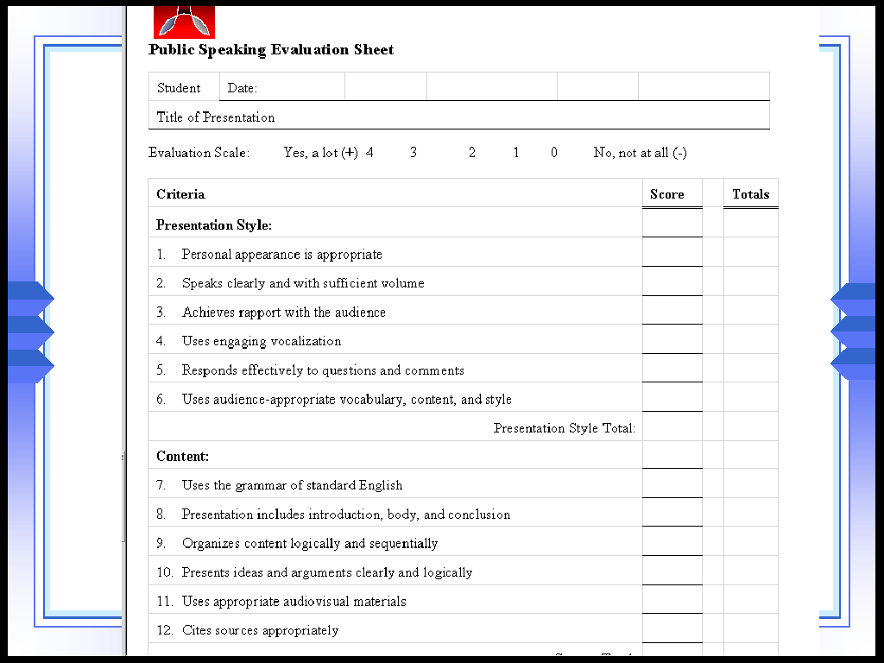
Performance Criteria/ Indicators – Public Speaking

Slide 128
Programme Outcome Assessment Matrix
Outcome indicators & core courses | Outcome 1 | Outcome 2
Project Report | A | B
Course 1 | B | B
Course 2 | C | B
A: slightly, B: moderately, C:substantively - base on a review of course materials (syllabus, learning objectives, tests, other assessment…..)
Outcome 1: ability to …..
Outcome 2: ability to …..

Slide 129
Course Assessment Matrix
Outcome-related learning objectives | Outcome 1 | Outcome 2
Explain | A | C
Perform calculation | B | B
Identify | B | B
Solve | B | C
A: slightly, B: moderately, C:substantively
Outcome 1: ability to …..
Outcome 2: ability to …..

Slide 130
Exercise 2
Discuss on the different EAC Programme Outcomes, and briefly explain how can they be measured.

Slide 131
Developing Course Outcomes that address the taxonomy

Slide 132
Course Development
Content - typical stuff
Learning (Topic) Outcomes - teaching plan
Course Outcomes - group of learning (topic) outcomes
CO-PO matrix – is it satisfactory?
Things to consider
Depth – e.g.Bloom’s taxonomy
Delivery and assessment
Students’ time and competencies covered

Slide 133

Creating a Course
Planning
  Identify course content and defining measurable learning outcomes
Instruction
  Select and implement methods – deliver the specified content and facilitate student achievement of the outcomes
Assessment and Evaluation
  Select and implement methods – determine how well the outcomes have been achieved

Slide 134
Why are course outcomes important?
They are essential because they:
define the type and depth of learning students are expected to achieve
provide an objective benchmark for formative, summative, and prior learning assessment
clearly communicate expectations to learners
clearly communicate graduates’ skills to the stakeholders
define coherent units of learning that can be further subdivided or modularized for classroom or for other delivery modes.
guide and organize the instructor and the learner.

Slide 135
3 components of a learning outcome
1) Action verb
Ability to:
describe the principles used in designing X.
evaluate the strengths and weakness of …
Well-written verbs must
be (SMART)
Specific
Measurable
Achievable
Realistic
Time frame
Observable
Try to avoid these:
- understand
- appreciate
know
learn
aware
familiar

Slide 136
3 components of a learning outcome
2) Condition (context under which the behaviour is to occur)
describe the principles used in designing X.(V)
orally describe the principles used in designing X. (V&C)
design a beam. (V)
design a beam using Microsoft Excel design template . (V&C)

Slide 137
3 components of a learning outcome
3) Standard (criteria of acceptable level of performance)
describe the principles used in designing X.(V)
orally describe the principles used in designing X. (V&C)
orally describe the five principles used in designing X. (V&C&S)
design a beam. (V)
design a beam using Microsoft Excel design template . (V&C)
design a beam using Microsoft Excel design template based on BS 5950:Part 1. (V&C&S)

Slide 138
Learning outcomes by adding a condition and standard
Poor
Students should be able to design research.
Better
Students should be able to independently design and carry out experimental and correlational research.
Best
Students should be able to independently design and carry out experimental and correlational research that yields valid results.
Source: Bergen, R. 2000. A Program Guideline for Outcomes Assessment at Geneva College

Slide 139
Course Outcomes
Statement … explain, calculate, derive, design, critique.
Statement … learn, know, understand, appreciate – not learning objectives but may qualify as outcomes (non-observable).
Understanding cannot be directly observed, student must do something observable to demonstrate his/her understanding.

Slide 140
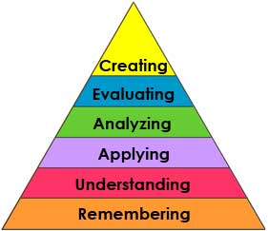

New Bloom’s Taxonomy
Bloom’s Taxonomy
Knowledge (list)
Comprehension (explain)
Application (calculate, solve, determine)
Analysis (classify, predict, model,derived)
Synthesis (design, improve)
Evaluation (judge, select, critique)

Slide 141
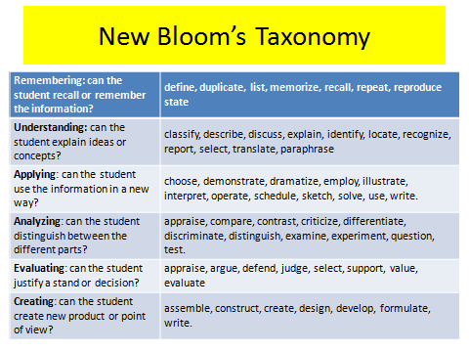

Slide 142
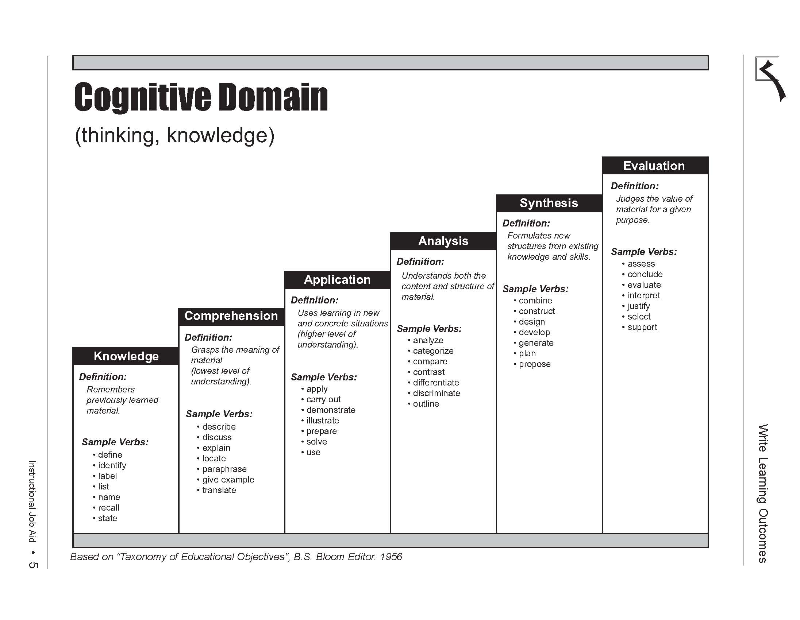
lower order
Intermediate
Higher order

Slide 143
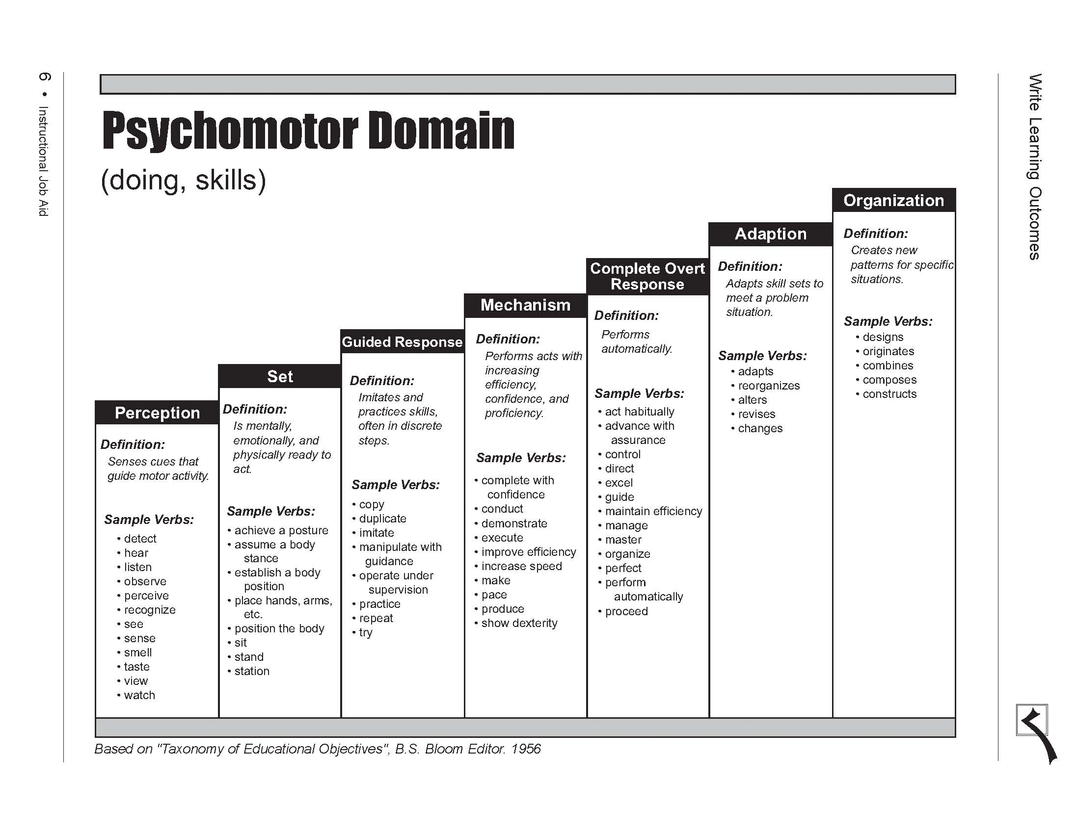
lower order
Intermediate
Higher order

Slide 144
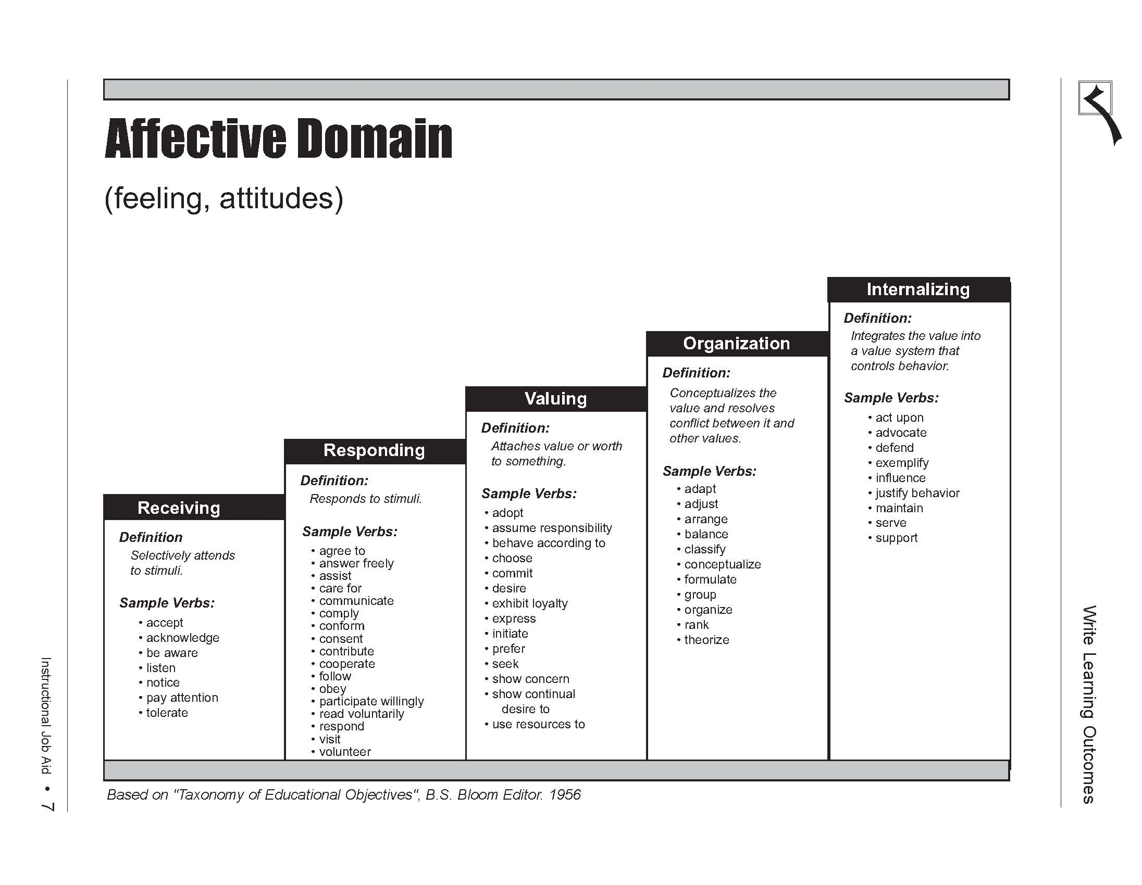
lower order
Intermediate
Higher order

Slide 145
Course Outcomes (CO) Contribution to Programme Outcomes (PO)
Ability to function in multidisciplinary team
Assign multidisciplinary design projects in engineering courses.
Implement design projects with multidisciplinary teams
Exercise:
Identify a course and discuss how it can be implemented

Slide 146
Course Outcomes (CO)Contribution to Programme Outcomes (PO)
Broad education necessary to understand the impact of engineering solutions in a global, environment and societal context + knowledge of contemporary issues
Include structured controversies in engineering course
Conduct class exercise or homework problems that involve global/societal issues
Exercise:
Identify a course and discuss how it can be implemented

Slide 147
Course Outcomes (CO) Contribution to Programme Outcomes (PO)
Life Long Learning
Teach students about learning styles and help them identify the strength and weakness of their styles and give them strategies to improve
Use active learning methods to accustom them to relying on themselves
Give assignments that requires library and www searches
Anything done to fulfil criteria on: (a) understanding ethical and professional responsibility and (b) understanding societal and global context of engineering solutions, will automatically satisfy this criteria

Slide 148
Typical teaching plan format
Remember KSA
Topics | Course outcome | Delivery method | Assessment | Indicator | Students contact time | Instructors contact time

Slide 149
Exercise 3
Identify a course and produce several learning outcomes and their associated assessments
Propose a matrix of course learning outcomes and assessments against EAC programme outcomes

Slide 150

Job as a Lecturer
What do you think of your job as a lecturer?
TOO MUCH WORK
IT SUCKS

Slide 151


Slide 152

Thank you
Diversity within Consistency

Slide 153
Appendix

Slide 154
1. Assign yourself an anonymous name
2. Rate between 1 to 5 with 1 “not at all” and 5 “yes a lot”
 |  | Before Workshop | After Workshop
B | My knowledge of delivery method is at level
(i) I would like to know more about …..
(ii) Comments:

Slide 155
Students Learning

Slide 156
Know your students
Academic background
Learning styles
Cultural background

Slide 157


Learning Style Model
Perception Sensing Intuitive
Input Modality Visual Verbal
Processing Active Reflective
Understanding Sequential Global

Slide 158

Visual (Vs) Learners | Verbal (Vb) Learners
“Show me” | “Explain it to me”
- pictures | - spoken words
- diagrams | - written words, symbols (seen, but translated by brain into their Oral equivalents)
- sketches
- schematics
- flow charts
- plots

Slide 159


Active (A) Learners | Reflective (R) Learners
Tend to process actively (doing something physical with presented material, then reflecting on it) | Tend to process reflectively (thinking about presented material, then doing something with it)
Think out loud | Work introspectively
“let’s try it out and see how it goes” | “Let’s think it through and then try it”
Tend to jump in prematurely | Tend to delay starting
Like group work | Like solo or pair work

Slide 160

Sequential (Sq) Learners | Global (G) Learners
Built understanding in logical sequential steps | Absorb information randomly, then synthesize the big picture
Function with partial understanding of information | Need the big pictures (interrelations, connections to other subjects and personal experience) in order to function with information
Make steady progress | Large leaps in understanding with little progress between them
Explain easily | Can’t explain easily
Good at analytical thinking (the trees) | Synthesis, holistic thinking (the forest)

Slide 161
Sensor & Intuitor
SENSOR – favours information that comes in through their senses. Attentive to details and do not like abstract concepts. Like well-defined problems that can be solved by standard methods
INTUITORS – favours internally generated information (memory, conjecture, interpretation). Can handle abstraction and bored by details. Prefer problems that call for innovation.

Slide 162
Approach
Professors are mostly intuitors, who emphasise basic principles, mathematical models and thought problem
Engineering students are mostly sensors, favour observable phenomena, hard facts, problems with well defined solution methods
Thus the disparity between the teacher and the learner

Slide 163
Learning and Teaching Styles
SO WHAT?
Mismatch between learners & teachers. Teachers usually intuitors but learners can be any of the 4 types.
WHAT TO DO?
Include various active teaching techniques to address ALL learning styles centered on the students i.e. Student Centered Learning (SCL)

Slide 164

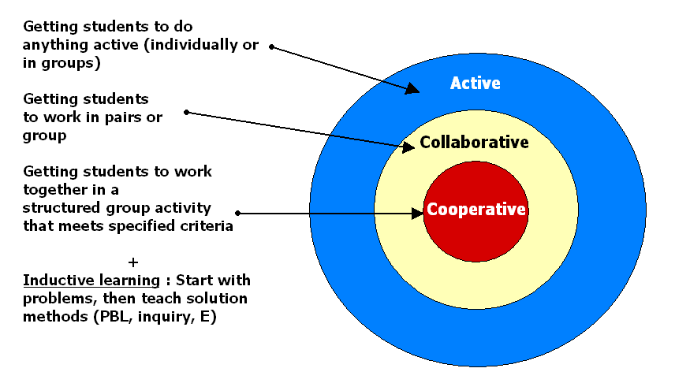
Student-Centered Learning

Slide 165
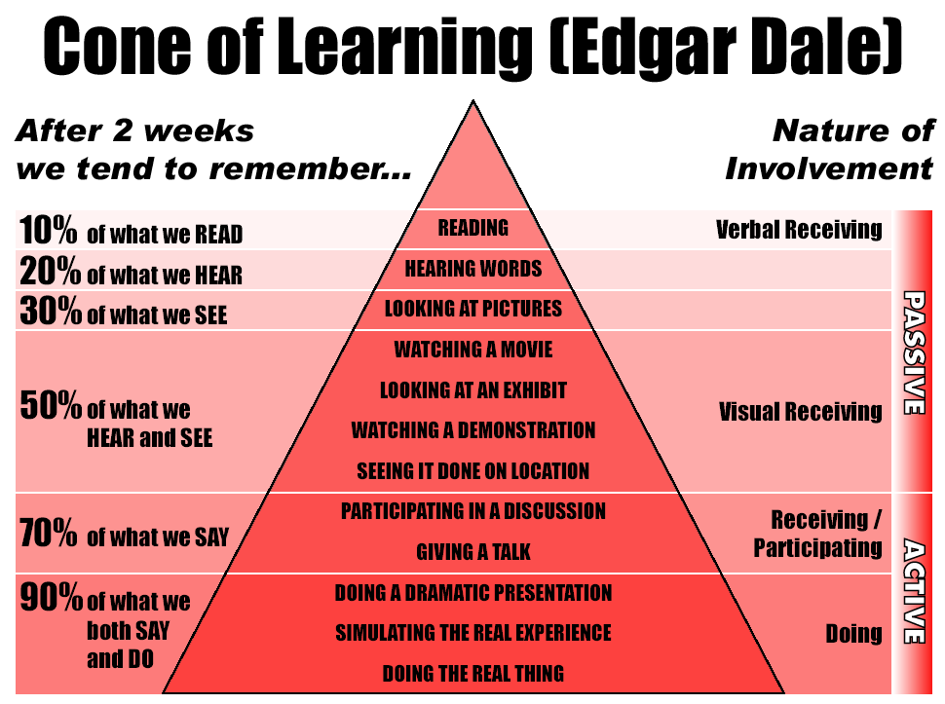

Slide 166
How can you best help students achieve it?
Lectures, demonstration, laboratories
Projects (design, research) and field experience
Multimedia lectures and tutorials, interactive simulations, web based instruction
Writing, speaking assignments
Student centred learning

Slide 167

Socratic Concept
Knowledge originates from the pupils through the skillful questioning of the teacher

Slide 168
Case Method
Case method is typically applied for graduate supervision or teaching a small group seminar/class at many places
Harvard Business School, however, has classes up to 180 pupils and organises its teaching through (10%) lectures and (90%) cases

Slide 169
Case Method – cont…
It includes small group, buzz group and large group discussion and a variety of other approaches that enable wide engagement between students and instructor
The faculty must master, communicate and also manage classroom process
Educates students to think creatively about the field and master it

Slide 170

Why are cases used?
Learn by doing and teaching others
Repetitive opportunity to identify, analyse and solve a number of issues in a variety of settings – prepares students for work
Allows to take the role of a specific person/organisation – real life situation

Slide 171

Why are cases used? Cont….
Practice on real thing harmlessly
A tool to test the understanding of theory, connect theory with application, and develop theoretical insights
Cases provide information about how work is planned and organised in various settings, how systems operate and how organisation compete

Slide 172

Why are cases used? – cont….
Access to information may be limited as in real life, helps to tolerate incompleteness
Discussion based format also provides self confidence, ability to think independently and work cooperatively
Cases engage students in the process of learning

Slide 173
Skills developed from Case Method
Analytical – qualitative and quantitative frameworks to analyse, problem identification, data handling, critical thinking – carefully sifting data
Decision making – generate alternatives, select decision criteria, evaluate alternatives, formulate implementation plans

Slide 174
Skills developed from Case Method – cont…..
Application – opportunity to practice using tools, techniques, and theories the students had learned
Oral communication – Listening, expressing, construct argument and convince a view – learning to think on your feet, consider other viewpoints and defend positions

Slide 175

Skills developed from Case Method – Cont…..
Time management – schedule educational activities within a time constraint
Interpersonal – discussion allows learning how to deal with peers – conflict resolution, compromise
Creative – invites imagination in problem solving, as there are multiple solutions
Written communication – note taking, case report, case exam

Slide 176
Problem-based Learning
Difference between problem-based learning and case method is not much as both pose problem but case looks for feasible solutions (not single answer) and identify the best

Slide 177

PROJECT/PROBLEM BASED
Project (design) oriented organised from first year
  Deals with know-how problems
  Solved by theories and knowledge from lectures
Problem oriented
  Deals with unsolved problems
  Within science and engineering
  Know-why approach
  Supported by relevant lectures

Slide 178

How will you know what they have achieved it?
Formative Assessment
Sumative Assessment
Course Assessment
Program Assessment
Assessment Tools
Direct and Indirect Assessment

Slide 179
How do you close the loop ?
Assessment Plan
Who is doing what and when
Stakeholder participation
CQI in place

Slide 180
Exercise 4

Slide 181
Scenario
OneMalaysia University decided to start a new “general” engineering programme (Bac of Eng) in addition to the existing two programmes. The existing programmes have only one common programme objective, i.e., “to produce engineers (according to the related field). The team which includes you is responsible to develop the new programme, and had decided to expand the programme objectives to include
  Global player
  Leading in advanced design

Slide 182
Questions
Identify the appropriate POs for the new programme, and link them to the PEOs
Identify the suitable taxonomy level for the respective POs.
A course, Strength of Materials has been identified as a fundamental course for the new programme. Develop the course outcomes and identify the appropriate taxonomy level.

Slide 183
Questions
How would you assess the course’s cognitive outcomes?
If you have to include non-cognitive outcomes, what are the possible assessment techniques to be employed?
Establish a mechanism to demonstrate attainment of the course outcomes (both formative and summative)
Show that the course outcomes contribute to the programme outcomes.

Slide 184
Exercise 5
 | PO1 | PO2 | PO9 | PO10
CO1 | + | +
CO2 |  | + | +
CO3 | + |  |  | +
CO4 |  |  | + | +
How would you design the assessment for the above matrix?

Slide 185
Exercise 6
Table 1
Q1 | CO1 | +
Q2 | CO2 | -
Q3 | CO3 | +
Q4 | CO4 | +
Discuss on the attainment of COs
and POs (using Exercise 5)for both
Tables, 1&2
Table 2
Q1 | CO1 | + | CO2 | +
Q2 | CO2 | + | CO3 | -
Q3 | CO3 | - | CO4 | +
Q4 | CO4 | + | CO1 | -

Slide 186
Exercise 7
 | PO1 | PO2 | PO3
C1 | 3 | 2 | 1
C2 | 2 | 1 | 2
C3 | 3 | 0 | 3
C4 | 2 | 1 | 3
Discuss on the potential problems, if any, where 3, 2, 1, and 0 refer to
High, Moderate, Low, and No emphasis, respectively. C1..4
refer to the courses, whereas PO1..3 refer to Programme
Outcomes.
How would cohort POs attainment be obtained?

Slide 187
Exercise 8
Delivery | Assesment
Lecture
Laboratory
PBL
Case Method
Project Based
Identify suitable assessment techniques for the different delivery modes.

